Slide 1
Accountability Work Group
February 7, 2022

Slide 2
Agenda
Welcome
2021 Request to Reconsider Update and Reflection
2022 State Accountability Update and Small Group Discussion
UIP Updates on Re-envisioning Process and Template Rollover
ESSA State Plan Amendment Update
Logistics

Slide 3

Welcome

Slide 4
Purpose of AWG
The Accountability Work Group (AWG) serves as a policy advisory group to explore ideas in support of federal and state accountability policies (e.g., Every Student Succeeds Act implementation, state accountability during the pause year) and make recommendations to the state. This group will consider input from other stakeholders, when available and appropriate, in developing recommendations.
It was first convened by the Commissioner of Education in 2014 to gather input on improving the state accountability performance framework reports. In 2016, the focus shifted to serving as the ESSA Accountability Spoke. In 2020, CDE shifted the group back to providing input on all accountability matters (both state and federal).

Slide 5
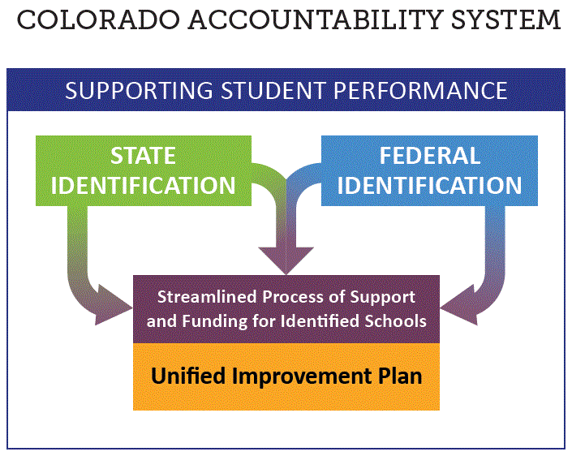
Accountability and Improvement

Slide 6

Intros and Icebreaker Activity
Use the Chat…
Introduce yourself: Name, role, organization
Best advice for 2022 in 4 words or less

Slide 7
Request to Reconsider Update

Slide 8
Amended Request to Reconsider Process for 2021-22
From HB 21-1161
  Only available to schools and districts on the accountability clock (Priority Improvement, Turnaround). AECs are included.
  Plan types may be adjusted, but not years on the clock. Two consecutive years at Improvement or higher are still needed to fully exit.
  An alternative body of evidence may include state and local assessments and input from the State Review Panel.
  State board may promulgate rules to determine time frame and process.
Scenario:
2019 SPF (Rating as of 2020-21) | 2021-22 (Approved R2R) | 2022-23 (Frameworks Resume) | 2023-24
Priority Improvement Y3 | Improvement Y3 | Improvement On Watch Y3 | Improvement (Exit performance watch)

Slide 9
DRAFT Recommendation Capture from AWG to Date
The Accountability Working Group (AWG) consists of regional superintendent representatives, school and district leadership, charter school leadership, CASE, CASB, CEA leaders, advocacy and civil rights group members and parents. The AWG has served as a policy advisory group to research and explore ideas in support of federal and state accountability policies and decision points and to collect input from additional stakeholders in developing recommendations.
Highlights to date:
  Proposed process worth the effort for districts/schools showing significant improvements
  Staged process (i.e., quantitative review, then qualitative review)
  Participation representativeness and data appropriateness to draw inferences of performance
  Local assessments nationally normed with validity/reliability evidence
  Approximations of performance relative to past state expectations
  Qualitative review should include review of the UIP and then a site visit
  The State Review Panel protocols should be amended to fit this process. The name should be changed to avoid confusion.
  An analysis of non-assessment data may be submitted, but not required
  Build in school improvement supports wherever possible

Slide 10
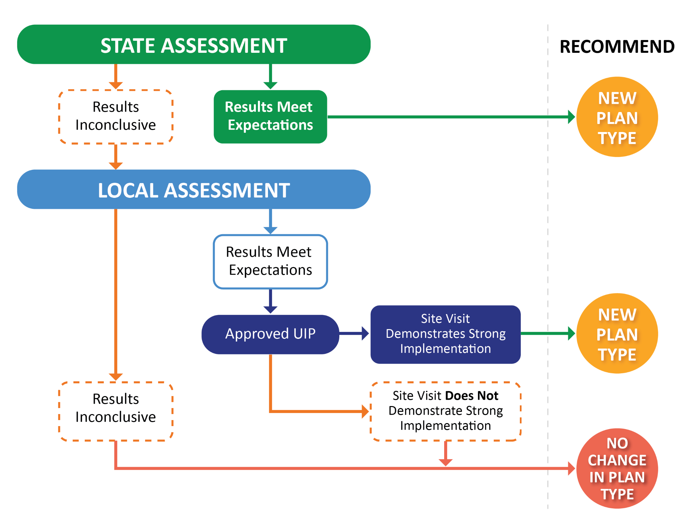
Request to Reconsider | 2021-22 Flow Map
Expedited Plus

Slide 11
Request to Reconsider | 2021 Pathways
 | Criteria
Expedited | Met 2019 performance framework expectations using 2021 state assessment data, and Had 85% or higher student participation on state assessments.
Expedited Plus | Met 2019 performance framework expectations using 2021 state assessment data, Had 75% - 84.99% student participation on state assessments, Had adequate student representativeness (+/- 5%), and Had an additional review phase that demonstrated they had a quality improvement plan (i.e., Unified Improvement Plan).
Body of Evidence | Met performance data thresholds on nationally-normed local assessments, Had 85% or greater student participation on the local assessment, Had an additional review phase that demonstrated they had a quality improvement plan (i.e., UIP), and Demonstrated implementation of their improvement plan through an External Review Team site visit.

Slide 12
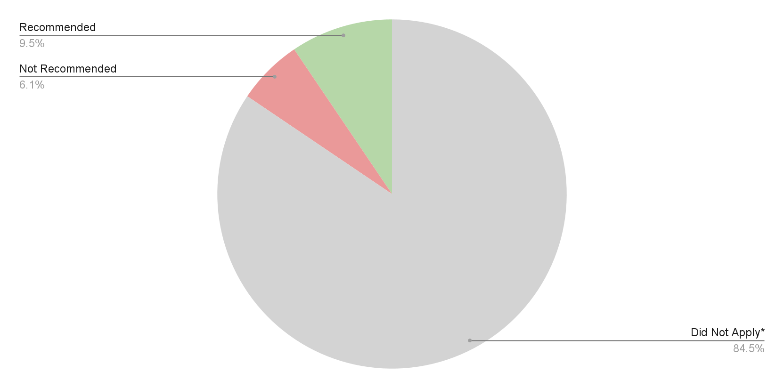
Request to Reconsider | Participants
14 schools
(rescind or district declined)
9 schools
125 schools
  *Does not include one school that closed after the 2020-21 school year.

Slide 13
State Board Approved 2021-22 Request to Reconsiderations by Review Pathway
Expedited Review
Expedited Plus Review
Body of Evidence Review
7 schools met expectations:
Canon City RE-1: McKinley Elementary School
Monte Vista C-8: Bill Metz Elementary School
Wiggins RE-50(J): Wiggins Middle School
Greeley 6: Madison Elementary School
Greeley 6: Shawsheen Elementary School
Charter School Institute: Coperni 2
Mesa County Valley 51: Chatfield Elementary School
5 schools met expectations:
Fountain 8: Jordahl Elementary School
Mesa County Valley 51: Central High School
School District 27J: Otho E Stuart Middle School
St Vrain Valley RE1J: Rocky Mountain Elementary School
Colorado Springs 11: Midland Elementary School
2 schools met expectations:
Estes Park R-3: Estes Park K-5 School
Pueblo City 60: Paragon Learning Center

Slide 14



Slide 15
Lessons Learned
Conducted expedited analysis and offered option to eligible schools. Some districts accepted.
Created an expedited plus option (state assessment data and UIP approval) for schools in the 75-85% participation range and with representativeness, after consulting with TAP.
For the body of evidence pathway, conducted the local data analysis, UIP review and site visits.
Lessons Learned:
  Participating schools/districts really appreciated the opportunity -- it was a celebration
  Lots of work!
  Representativeness measure may need work
  UIP review can be a filter
  Site visit protocol is being tested now
  What to use for the future?

Slide 16
Quotes from Participants
Thank you for maintaining the RTR process during the pandemic. We are very appreciative of this opportunity.
The site visit was the most helpful, but also the district assessment tool was really helpful. We are using that with our middle and high school data too, just because we think it is valuable insight even though those two school didn't undergo a request to reconsider.
It was very simple and easy. It would have been nice to know sooner if the school qualified because we either would have had to do quick work to go through the other pathway or have done work in advance that wouldn't have been necessary. So, possibly a longer time between notification regarding the expedited review and the deadline for the other pathway. I know time was tight and there were lots of moving pieces but we grappled with how to plan/prepare accordingly.
I really like this progress. It is much more rigorous than just looking at assessment data and provides our school with so much more valuable information and feedback that we can use for improving.
We determined that the expedited and the second level with UIP review would be as much effort we would probably spend to get a rating changed. Having site visits, etc. was just too much. We would most likely not participate in that level of RTR.

Slide 17
2022 State Accountability
Notes:
Lisa- Add Slides

Slide 18
Current Context for Accountability
Accountability Audit
Current policy landscape for fall 2022
  Full state assessment schedule in spring 2022
  Performance frameworks resume in fall 2022
  Elementary and Secondary Education Act (ESEA) identification process resumes in fall 2022
Consideration for 2022 frameworks
  We are still in a pandemic and moving toward recovery
  Many data elements will be available, but growth will be more limited (e.g., alternating grades/content area schedule in 2021, cannot offer 3-year frameworks).

Slide 19
Implications for the future: Accountability Audit
HB 21-1294: Audit of Statewide Education Accountability Systems
Audit is run by the Office of the State Auditor. They selected HumRRO to collect and evaluate the system.
CDE is providing data currently. HumRRO may approach districts for additional data. Report due by November 15, 2022; made public by December 2022.
The intent is to determine whether the current system:
  Meets the goals and intentions of the General Assembly, as stated in the legislative declarations set forth in Section 22-7-1002, C.R.S., and Section 22-11-102, C.R.S.
  Contains institutional or cultural biases based on race, ethnicity, religion, sex, sexual orientation, nationality, disability, age, or economic status.
  Provides an accurate, credible, and comparable assessment of public education throughout the state.

Slide 20
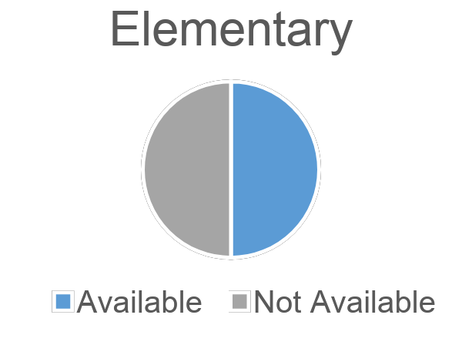
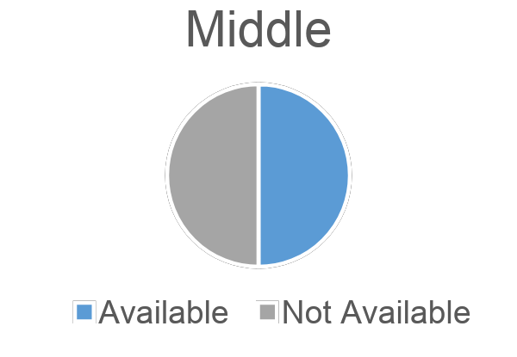
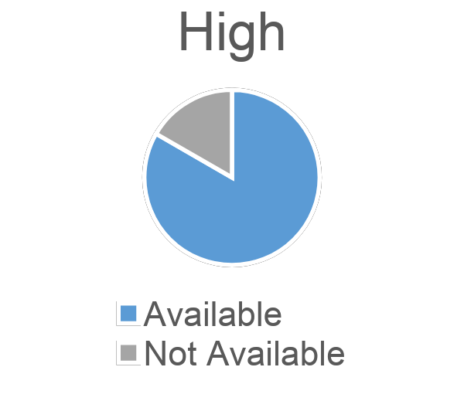
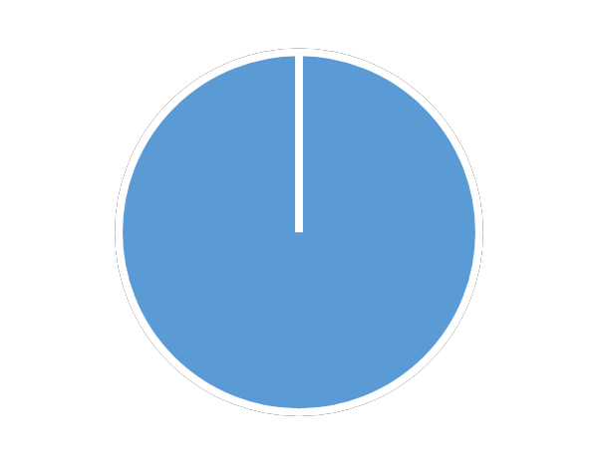
What Data Will be Available in 2022-23: Anticipating Performance Frameworks
Performance Indicator | Weight | Availability for 2022 Frameworks
Academic Achievement | 40% Elementary & Middle Schools 30% High Schools & Districts | Yes, assuming participation in spring 2022 assessment is adequate
Academic Growth | 60% Elementary & Middle Schools 40% High Schools & Districts | To some degree
Postsecondary and Workforce Readiness | 30% High Schools & Districts | Yes, assuming participation in spring 2022 assessment is adequate
1-Year Growth Availability in 2022
2 out of 4 possible grades/content available: 4th grade English/Language Arts and 5th grade Math
3 out of 6 possible grades/content available: 6th and 8th grade English/Language Arts and 7th grade Math
5 out of 5 possible grades/content available: 10th-11th grade Evidence Based Reading and Writing and 9 – 11th grade Math (Note: 8-9th grade growth in ELA/EBRW has not been historically released due to construct alignment issues)

Slide 21
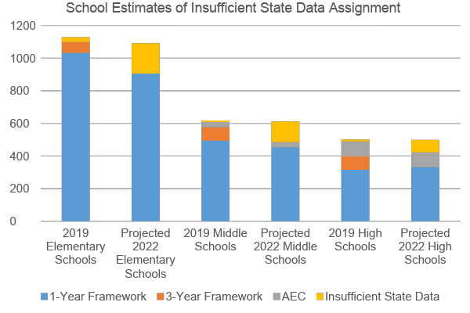
Projected Impact of Plan Type Assignment due to Data Availability
Summary of Increases in ISD
Elementary Projection: From 30 (2019) to at least 187 Schools (2022)
Middle Projection: From 10 (2019) to at least 128 Schools (2022)
High Projection: From 12 (2019) to at least 77 Schools (2022)
These estimates are based upon 2021 state assessment data. Because 2022 assessment data is not available yet, ISD plan types could be higher if participation is low.

Slide 22
Summary of Findings
Most schools and districts will have enough data to calculate a performance framework. More than usual will not.
Available data stands in for missing data fairly well.
The missing data introduces some differences in calculations.
Low student participation may impact accuracy and representativeness of plan type assignments.
The cumulative effect of these findings should be considered when examining options for 2022 accountability.

Slide 23
2022 Accountability
Summary: http://www.cde.state.co.us/accountability/2022accountabilityupdateandtlccsurveyreminder
State Board Resolution
  https://go.boarddocs.com/co/cde/Board.nsf/goto?open&id=C9JN495CB3F4
  #1: State assessments
  #2: 2022 accountability (statutory implications)
  #3: 2022 accountability (board rule implications)

Slide 24
Implications for the next few months
Introduction of proposed legislation will be key
State board (through rule process) will likely play a role
Timelines will be tight
Probable redesign for request to reconsider … again
Implications for framework calculations
Accountability clock will take a while to realign (rating and year)
Need for communication with the field, especially schools/districts on clock

Slide 25
Small Group Discussion on 2022 Accountability
Small Groups for further discussion on the State Board resolutions (and potential path for 2022 accountability). Use the pen to create a checkmark to the top 3 notes that resonate most.
Jamboard: https://jamboard.google.com/d/1eknw3oKLOyw9IzzVwICSA9KPdt-ByBnG3mTj6qODnaU/viewer?f=1
Questions to consider:
  What remaining questions do you have or clarifications that you need?
  What concerns do you have about the proposed path for 2022 accountability?
  What advice do you have for CDE in thinking about accountability practices (e.g., request to reconsider, framework release)?
  What advice do you have for CDE in providing support to the field (e.g., communication, resource development, technical assistance)?
Reminders
  Nothing about 2022 accountability is official yet
  This exercise is just focused on 2022 accountability, not about the broader future of accountability
  This will be an ongoing topic, especially as the policy landscape is clarified.

Slide 26
Quick PSA:
Teaching and Learning Conditions in Colorado (TLCC) Survey

Slide 27

TLCC 2022 Details
TLCC Website www.tlccsurvey.org
  Resources
  Survey launch button
  Help Desk
  Participation Tracker
  Results
New for 2022
  Addition of Education Support Professionals (ESP) (about 24,000)
    New questions for ESP and Special Service Providers
    Specific ESP only questions
  Student and Staff Wellness question additions – Pandemic Impacts
Open January 19- February 18
  Potential extension if necessary
Codes mailed and emailed to Association Rep or Principal
  If codes not received, contact help desk

Slide 28
Encourage Participation!
Staff can request a unique code through the Self Service Portal
Encourage school leaders to provide protected time to take the survey
Ideas for increasing participation: competitions, personal reminders, full staff rewards, finish line 50%
Share how results will be used at the school
Districts: share in communications, reminders to schools, share how district admin will use results
Results only available if 50% participation and 5 responses

Slide 29
UIP Re-Envisioning

Slide 30
Why this and why now?
The Unified Improvement Plan has existed for more than a decade
  Over time, requirements have been added to the UIP and/or changed within the UIP
Feedback from school and district users has been integrated each year, resulting in revisions to the UIP over time
The disruption caused by the pandemic can be taken as an opportunity to re-examine systems, such as the UIP
  Several stakeholder groups (e.g., COVID-19 Policy Implications Stakeholder Group; EDAC) shared feedback that the UIP had become overly complex
  Technology has advanced so more is possible within the online system

Slide 31
UIP Re-envisioning Purposes
Design an updated school and district UIP template that enhances the usability of the UIP.
Respond to feedback/input from the field.
Make the UIP requirements more explicit.

Slide 32
Themes from AWG Input
Simplified and streamlined is the right direction
Need to be thoughtful about what is retained and what is removed
Doing something only for ‘compliance’ is not helpful

Slide 33
Integrating AWG Input
Technology may be able to help streamline and simplify
  The changes may be more of a facelift, rather than a rebuild
Make the UIP more intuitive to complete (e.g., consider renaming UIP elements)
Create more clarity about requirements within the template (e.g., create a specific place for READ required data)
Differentiate the template based on school/district requirements
Build access to resources and supports into the template (e.g., examples, guidance)

Slide 34

Questions

Slide 35
Next Steps
CDE contract with developer to redesign the template
CDE gather more input from stakeholders
Determining timeline for changes (and whether some need ‘beta-testing’ with a smaller group)

Slide 36
ESEA State Plan Amendment Update

Slide 37
Accountability and Improvement
In Fall 2022, CDE is required to identify schools for support and improvement under ESSA. But we have the option to request one-year changes to the methodology due to missing data/state assessments. So, let’s discuss how to do identify schools this fall!

Slide 38
Purpose and Objective
Identify schools in need of support and improvement –
  Eligible for ESEA Title I School Improvement Funds
  Required to develop and implement an improvement plan that addresses the reasons for identification under ESSA
To align with state accountability to the extent feasible and possible given state and federal statutory requirements
  Regardless of how we identify schools, at this time, there will not be a perfect alignment between state and federal identification
  Areas of misalignment regardless of 2022 plans - ESSA requires
    Identification of schools based on performance of student groups, high schools based on graduation rates, schools that serve only K-2 students, and schools with low state assessment participation (no option of using “insufficient state data”)
    Based on 3-years of data (up to 5-years for smaller systems that would otherwise fall out of identification)
Ensure that our methodology
  Appropriately differentiates schools
  Prioritizes the schools with the greatest needs for limited resources available for support

Slide 39
Similarities and Disparities in State and Federal Identification
For academic achievement, must apply lowest possible score to non-participants
Must include as many years of data needed for all schools to get a rating
Includes additional categories of schools (see below)
40 CS – Lowest 5% and State Identified
Allows for Insufficient State Data
Can include 1- or 3-year Frameworks
Includes all schools in the state (with sufficient data to get a rating)
State
Federal
77 Identified for CS – Lowest 5% (Title I only)
Of which 3 are K-2
Of which 8 are due to participation only
96 State Identified (on Performance Watch; not ESSA Identified)
83 State and ESSA
199 ESSA Identified (not on Performance Watch)
65 Identified based on Graduation Rate only
140 Identified based on Student Group Performance
Of which 4 are K-2
Of which 8 are due to participation only

Slide 40
One-year Changes – Allowable Options
Indicator | Currently Approved Methodology | Options for Waiver/Requesting Changes | Pros/Cons or Rationale for Recommendation
Academic achievement in English language arts and math | Based on 3-year aggregated CMAS, SAT, and CoAlt mean scale scores (MSS) | Options: Request to use 1 year of data – 2022 Request to skip 2020 & 2021 & use 3 years - 2018, 2019, & 2022 Request to skip 2020 & 2021 & use 2 years – 2019 & 2022 | Aligns with state accountability for fall 2022/Will drastically change when we resume 3-year data use in 2023; concerns with identifying schools based on only 1 year of data, especially if 2022 participation is low Allows for use of 3-years to include smaller systems/concerns with aggregating pre-pandemic scores with 2022 Allows for adding 3rd year in 2023/concerns with aggregating pre-pandemic data
Academic growth in English language arts and math | Based on 3 years of aggregated median growth percentiles | Recommendation: Use 2022 median growth percentiles | Aligns with state accountability (see notes below). Also, it is not currently an option to use 3 years of aggregated median growth percentiles due to no assessments in 2020 and skip-grade assessments in 2021.
School quality or student success (SQSS) | Based on CMAS/CoAlt science MSS, and reduction in chronic absenteeism (elementary and middle schools) and dropout rates (high schools) | Recommendation: Request to only use dropout rates for 2022 only | No science data available in 2020, 2021, or 2022 Using chronic absenteeism as an accountability measure during a pandemic seems counterproductive to encouraging students, families, and school communities to stay home when sick or have symptoms to minimize the spread of COVID-19
Progress in Achieving English language proficiency (ELs only) | Based on 3 years of WIDA Access median growth percentiles and percentage of students on track to fluency | Recommendation: Use 2022 median growth percentiles and percentage of student on track to fluency, but request for a reduction on in the weighting of the on-track metric and a reset of the cut scores | Aligns with state accountability use of ELP growth.
Graduation rate (high schools only) | Based on 4- and 7-year adjusted cohort rates | Recommendation: Continue to use 3 years of 4- and 7-year adjusted cohort rates | Allows for consistent use of graduation rates. Aggregating across years and multiple graduation rates allows for minimizing significant weight of any 1 year.
Notes:
Three years of growth using 2018, 2019, and 2022 data poses additional challenges, and would require either using cohort growth or recalculating 2018 and 2019 using baseline growth.

Slide 41
Discussion Needed Today
For the academic achievement indicator, should the ESSA identification:
  Be the same as state accountability – only use 2022, even if that may result in over identification of schools if their participation rates are low or their performance has significantly dropped due to the pandemic?
  Continue to use 3 years of data (2018, 2019, & 2022), even if 2 of the years are old data and pre-pandemic?
  Use only 2 years of data in 2022, even if that does not align with state accountability and includes 1 year of pre-pandemic assessments and 1 year of current data?
What questions or concerns do you have about each of these options?
Which of these seems fair/appropriate? Why?
Which factors should be prioritized for ESSA identification methodology? For example:
  Alignment with state identification?
  Using multiple years of data?

Slide 42
Contact Information
Nazie Mohajeri-Nelson, mohajeri-nelson_n@cde.state.co.us
Tina Negley, Negley_t@cde.state.co.us

Slide 43
2021-22 AWG Logistics

Slide 44

Meeting Routine and Arc of the Year
Meeting Structure
  Meet once a month for 2 hours, Mondays 2-4.
  Will build in smaller work groups, but may not be recurring like last year.
Arc of the Year
  Flexibility will be key.
  Focus on accountability 2022.
  Suggestions?

