Slide 1
Colorado Transitional Accountability: Performance Frameworks and Next Steps 2022-23 September 2022

Slide 2
Agenda
Accountability Context
High Level Overview 2022-23
Current State
Participation
Specific Scenarios (Insufficient State Data)
Timeline
Resources Overview

Slide 3
Context

Slide 4
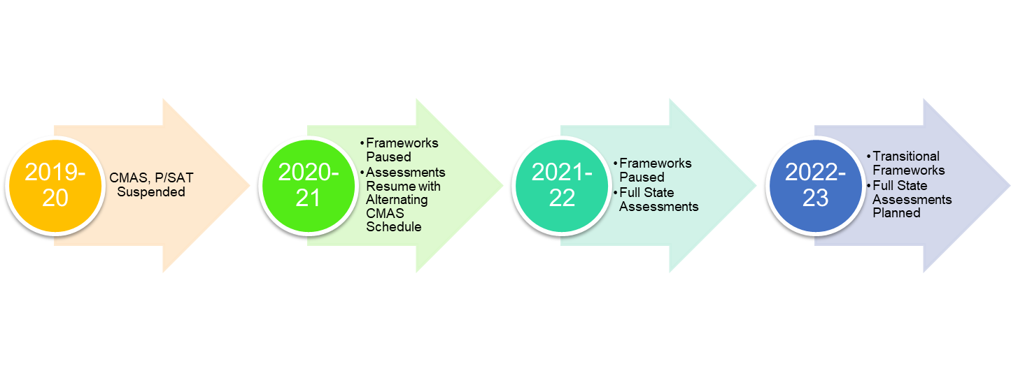
Timeline
Pandemic Impacts
Variability Across State
Conditions
Shifting Policy
Limited Data Availability

Slide 5
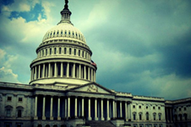
SB 22-137 - Transition Back to Standard K-12 Accountability
Restarts framework calculations for fall 2022 using 2019 statewide performance indicator targets.
Addition of growth participation rate to framework reports.
Accreditation and plan type ratings will be assigned, but clock status will not automatically advance (on or off).
Change in clock status may be approved through request to reconsider process, and opens request to reconsider process back up more broadly.
Clarification that State Board may take into consideration the 2022-2023 plan type for schools and districts (currently 12 schools and 2 districts) with directed action.
Expands the School Transformation grant (currently embedded with EASI grant) to districts with Improvement plan type.
SB 22-137

Slide 6
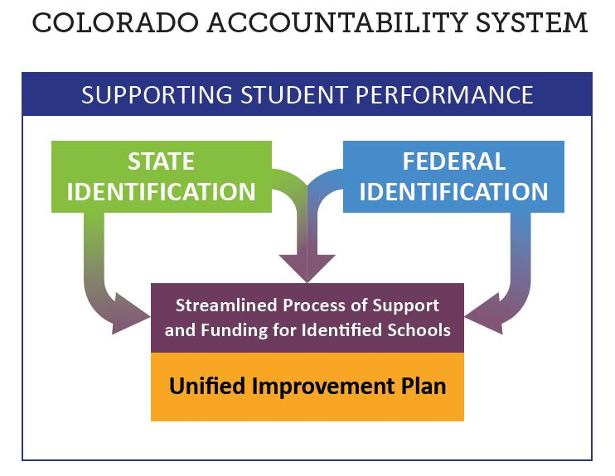
Identifications
Both state and federal accountability identifications will occur in 2022.
The U.S. Department of Education has approved the state’s waiver to make some adjustments to the process in light of the two-year pause. Changes are described on the website for the ESSA plan.
This webinar will primarily focus on implications of state policy.

Slide 7
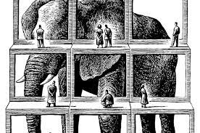
High Level Overview

Slide 8
Growth Pathways for 2022
21-22 Student Grade Level
4
5
6
7
8
9
10
11
2021* State Assessment
CMAS Gr 3 - ELA
CMAS Gr 4 – Math
CMAS Gr 5 – ELA
CMAS Gr 6 – Math
CMAS Gr 7 – ELA
CMAS Gr 8 – Math
PSAT 9 – EBRW & Math
PSAT 10 – EBRW & Math
2022 State Assessment
CMAS Gr 4 – ELA
CMAS Gr 5 – Math
CMAS Gr 6 – ELA
CMAS Gr 7 – Math
CMAS Gr 8 – ELA
PSAT 9**-EBRW & Math
PSAT 10 – EBRW & Math
SAT 11 – EBRW & Math
*Due to the alternate CMAS testing schedule in 2021, students in grades 3, 5, and 7 took only ELA, and students in grades 4, 6, 8 took only Math. This results in limited growth availability for 2022.
**No growth will be reported crossing from CMAS ELA to PSAT EBRW due to differences in assessment constructs.

Slide 9
Notes on Growth
Cohort-referenced growth will be used for framework calculations and weights will remain constant. Baseline-referenced growth is provided for informational purposes only (flat files and dashboards).
Growth participation rates will be reported on the 2022 performance frameworks. This calculation represents how representative the reported growth results are likely to be of the eligible student population.
This column on the 2022 frameworks represents the growth participation rate.

Slide 10
Terminology Check
Performance Watch
Accountability Clock
Unique to 2022
Priority Improvement/ Turnaround
Year 0
Priority Improvement or Turnaround
Year 1+
Performance/ Improvement
On Watch
Year 2+
Priority Improvement/ Turnaround with State Board Action
Year 5+

Slide 11
Overall Preliminary Rating Patterns
Number of schools and districts with distinction, performance and improvement ratings
Number of schools and districts with priority improvement and turnaround
Number of schools and districts with insufficient state data ratings

Slide 12
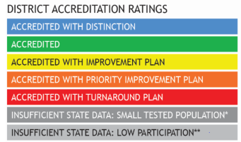
School and District Transitional Framework Ratings
Ratings
Descriptors
Meets Participation
Above 95% total participation rate in 2 or more content areas*
Low Participation
Below 95% total participation rate in 2 or more content areas*
Decreased Due to Participation
Below 95% accountability participation, once parent excuses are removed, in 2 or more content areas
+
*Science participation is included for informational purposes only in 2022.

Slide 13
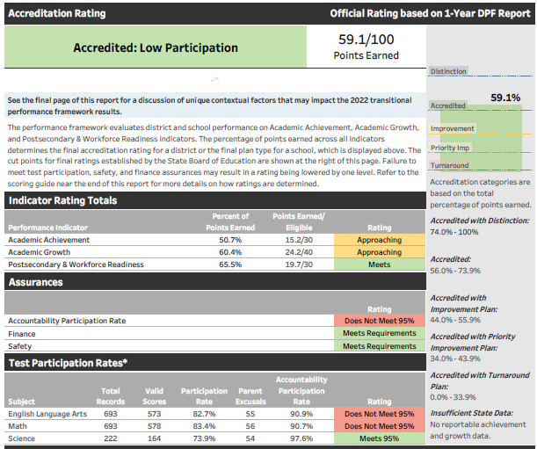
Delay of Performance Frameworks to Districts
Look for “flag” of state assessment participation concerns
The issues identified were related to participation codes and students who otherwise would not have received a score
The coding errors did not impact student scores and overall performance framework results.
The requirement will resume for the 2023 frameworks.

Slide 14
Insufficient State Data (ISD) Ratings
Insufficient State Data (ISD) Ratings are assigned when the state does not have enough data to assign a rating or plan type.
There are multiple reasons an ISD rating can be assigned, including:
Small Tested Population
No Students at Grade Levels Tested for State Assessments
In 2022, no achievement, growth, or postsecondary workforce readiness data
For multilevel schools, this also applies if one or more elementary, middle, or high school levels do not have reportable data for achievement or growth
In 2022, less than 25% total participation in English language arts and math (science participation is included for informational purposes only in 2022)
In 2022, AECs are eligible to receive an ISD rating

Slide 15
Accreditation and Request to Reconsider

Slide 16
District and School Accreditation General Process
CDE reviews performance
Districts review and verify ratings
Districts can request reconsideration
Ratings are finalized by the state board
Districts sign their accreditation contract
August
September
October
November/December
December
The Education Accountability Act of 2009 (S.B. 09-163) and H.B. 18-1355 authorize the Colorado Department of Education to conduct an annual review of the performance of public schools and districts in the state.
Districts have the opportunity to review and verify the state identified district accreditation rating or school plan types using the School Accreditation and Request to Reconsider form (available in the Accreditation portal within the UIP online system).
If the district disagrees with the initial rating/plan type, then additional performance data may be submitted to the department using the Accreditation portal.
Preliminary ratings/plan types and requests to reconsider are approved and finalized by the State Board of Education.
Once the district’s rating and all school plan types are finalized, districts that are rated Improvement or below must sign the district’s accreditation contract. Contracts for districts rated Accredited or above will be automatically renewed unless a new contract is requested.

Slide 17
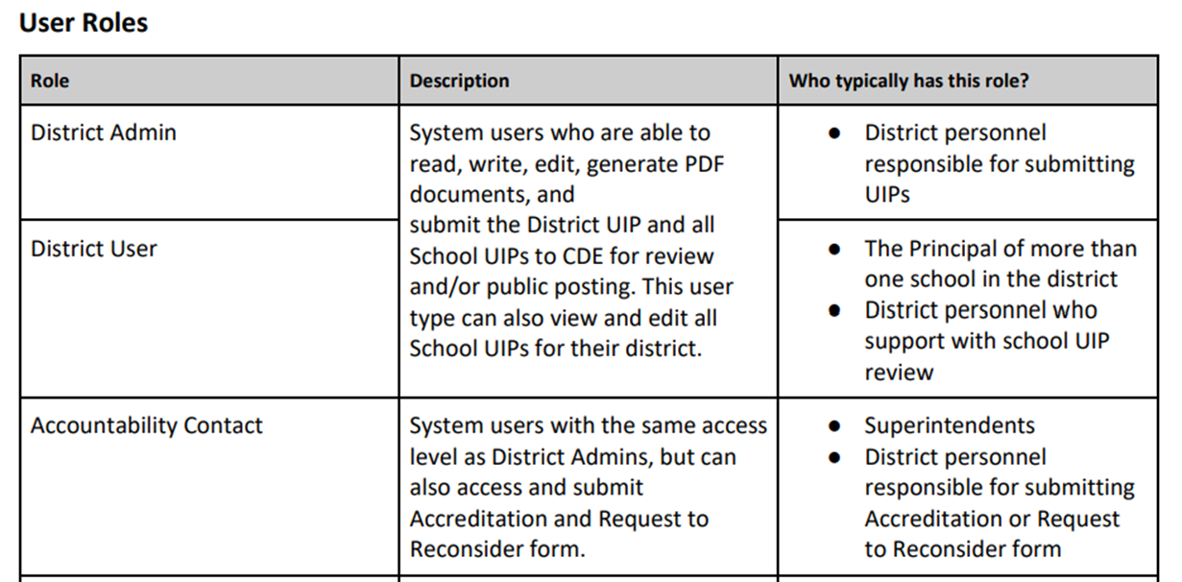
Accessing the School Accreditation and Request to Reconsider Form
Does your district have updated accountability contacts?
Current List of Accountability Contacts
Link to a description of the process and to access the form to update contacts
Did your district’s Local Access Manager (LAM) designate your system login role from “District Admin” or “District User” to “Accountability Contact”?
UIP Online System User Setup Management
Still don’t have access to the form? Contact your district’s LAM to request they change your system login role using this form: https://edx.cde.state.co.us/CDEIdM/districtLAMSupport.jsp.

Slide 18
2022 Request to Reconsider Process
Request to reconsider is the district’s opportunity to request reconsideration of a school or district’s preliminary plan type based on additional evidence.
The board adopted rules that reflect an eligibility requirement of 90% total participation on state assessments for 2022.
Request to reconsider becomes the avenue for schools/district to adjust clock years (e.g. exit Performance Watch, move to On Watch) in 2022.
Notes:
Sites may use request to reconsider to move to “On Watch” or fully exit the accountability clock if they meet certain conditions.
Because of the 90% total participation rate eligibility requirement, certain historical practices (e.g., ability to request Insufficient State Data with less than 85% participation rate if the district or school is able to demonstrate that data is not representative) will not be available.

Slide 19
Background on Participation in Frameworks
Total participation parent excusals are counted as non-participants (i.e., they are included in the denominator)
Accountability participation parent excusals are excluded from the calculation
These ratings reflect whether accountability participation rates meet or exceed 95%.

Slide 20
2022 Request to Reconsider Timeline
Final Request Materials Due
Final request materials (e.g., district narrative, local data) are due.
September 2
September 23
November & December
October 25
Preliminary Frameworks Released
School and district ratings are released to districts.
School Accreditation & Request to Reconsider Form Submissions Due
To initiate the process, the accountability contact will need to “disagree” with the preliminary rating and/or clock status using the Accreditation and Request to Reconsider form.
District and School Plan Types Finalized during the State Board Meeting
For districts and schools, ratings will be considered final after the state board meeting.

Slide 21
R2R Condition / Pathway | Description (to participate in 2022 R2R schools/districts are required to have 90% total participation on state assessments)
Expedited Clock Adjustment* | For schools and districts on the clock or on watch, if state data demonstrates 90% total participation and a rating of Improvement or higher, the district will be notified of their eligibility for an expedited recommendation to change the school/district clock status. Additional evidence not needed. District needs to confirm clock adjustments using the accreditation form.
Impact of Alternative Education Campuses* | Districts may request the removal of AEC results from overall DPF rating calculation, as long as all AECs have earned Performance ratings in the current year. Districts with only AECs may elect to use the AEC framework rating as the district accreditation rating.
Districts with a single school* | Districts with a single school may elect to use the calculated SPF rating as the district accreditation rating.
Body of Evidence | School/district may provide supplemental evidence of different performance than preliminary state assignment. Need 95% total participation on local assessments (nationally normed). AECs or schools/districts with an ISD rating cannot participate in this request condition.
Extenuating Circumstances | School/district with extenuating circumstances (i.e., “Act of God”) may submit a request based on conditions that impacted the state assessment administration window (cannot include pandemic impacts). This is part of the Body of Evidence condition.
Accountability Participation Impact | Districts and schools that had their rating “decreased due to participation” by not meeting the 95% accountability participation rate in two or more content areas may make a request if the requirement was not met due to reasons other than parent refusals (e.g., test misadministrations) or due to issues with N counts for smaller systems.
Calculation Error | Districts and schools that had a mathematical calculation error in the data in their framework may make a request. This generally excludes data submission concerns through the Student Biographical Data (SBD) collection.
Districts with a closed school | Districts with Priority Improvement or Turnaround Plan types that have closed a school due to low performance may request a recalculated DPF with the results of the closed school removed.
*CDE informed districts on their eligibility for this condition.

Slide 22
2022 Accreditation and Request to Reconsider Support
Accreditation and Request to Reconsider Guidance: Available on the CDE website.
Informational Webinar: Occurred August 15th at 1pm, recording and slides are available on the CDE website.
Office Hours: Began Wednesday August 17 and will be held from 2-4pm every Wednesday and Thursday until the process concludes, click here to register
General Contact: Aislinn Walsh, walsh_a@cde.state.co.us or (720) 614-2151

Slide 23
Timeline

Slide 24
UIP Timeline Flexibilities
At district discretion
Biennial Flexibility- District Option for submitting a UIP for public posting every other year. Insufficient state data not eligible. In online UIP and posted spreadsheet.
Combined Plan Flexibility- Submitting one plan for all schools and district level. Under 1000 automatic, 1000-1200 CDE approval.
January 17th UIP Submission- additional requirements to be met in plan, may need additional time: Year 0, Request to Reconsider, New ESEA Comprehensive Support
Just because you can, doesn’t mean you …have to.

Slide 25
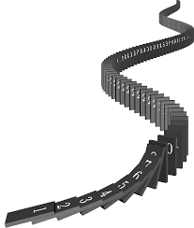
Adjusted Timelines-Performance Framework Delay
School Accreditation and Request to Reconsider Form Submission Deadline
September 15 → September 23
Request to Reconsider Materials Due
October 17 → October 25
Unified Improvement Plan (UIP) Submission Deadline
October 17 → October 25

Slide 26
Key Dates for 2022
Anticipated Timeframe | Activities/Actions
June 24 | Districts Received ACCESS Growth Data
August 9 | Districts Received CMAS and P/SAT Growth Data
August 16/17 (SBE Meeting) | Public Release of Colorado Growth Data Results
September 2 | Preliminary Performance Frameworks Released to Districts
September 8 | Preliminary Performance Frameworks Released to Public (flat file), published in online UIP dashboard
Early September | ESEA Identifications Released to Districts
September 23 | School Accreditation & Request to Reconsider Form Submissions Due
October 25 | Unified Improvement Plan Submissions Due For Districts/Schools going through request to reconsider, final request materials are due.
November 10-11 (SBE Meeting) | District Accreditation Ratings & School Plan Types final for Districts/Schools not going through request to reconsider
December 14-15 (SBE Meeting) | District Accreditation Ratings & School Plan Types final for Districts/Schools going through request to reconsider
January 16, 2023 | Newly identified schools and districts eligible to submit plans for CDE review until January 16, 2023.

Slide 27
Resources & Contacts

Slide 28
Accountability Document Resources
2022 Summary Change (DOC) - August 2022. This document describes the changes related to accountability and improvement planning for 2022.
2022 Annotated Framework Report (PDF) - August 2022. This resource is an annotated report that identifies key information and changes to the performance framework report since the prior release.
Participation and Accountability Guide (DOC) - August 2022 This resource describes assessment participation requirements and the role of participation in both state and federal accountability.
Performance Watch Labels and Progression (DOC) - August 2022 This resource describes the performance watch process for the 2022-2023 school year and the associated requirements for each plan type, clock year, and performance watch status.
District Accountability Handbook (PDF) - August 2022 This handbook provides an outline of the requirements and responsibilities for the state, district, and school stakeholders in the state’s accountability process.
Priority Improvement and Turnaround Districts and Schools: A Supplement to the CDE District Accountability Handbook (PDF) - August 2022 This supplement provides further details on the requirements and responsibilities for the state, district, and school stakeholders for those identified as Priority Improvement and Turnaround.
Parent Notification and Public Hearing Requirements Fact Sheet (DOC) - August 2022 This document walks through the requirements for notifying and engaging stakeholders.

Slide 29
Key Webinars/TA
Accountability Overview This webinar will provide a description of Accountability for 2022, with an emphasis on state accountability. There will be an overview of high level results and considerations for plan types, accountability actions and improvement planning. There will be a time for question and answer. The presentation will be recorded and made available for later viewing.
Insufficient State Data Rating For schools and district identified with an Insufficient State Data rating, this webinar covers the rating definition, description, and general considerations for improvement planning
Educational Accountability 101 Webinar This webinar will provide an overview of Educational Accountability including the district/school performance frameworks for the 2022-2023 academic year. In addition, updates for the current year along with the locations of data files and tools will be shared.
UIP Submission & District User Dashboard Webinar This webinar will provide an overview of this year’s UIP submission process, including exercising biennial flexibility, combined submission, and January submission. A walkthrough of the dashboards available to district-level users in the UIP Online System will also be provided.
Accountability Webinar (Recording and PowerPoint) - CDE staff hosted a webinar on June 29th to provide an overview and updates on accountability for the 2022-23 year. The webinar included a description of policy decisions that are unique to this school year.
School Accreditation and Request to Reconsider Office Hours​ Office hours are available for any schools or districts who need support on the 2022 accreditation or request to reconsider process.

Slide 30
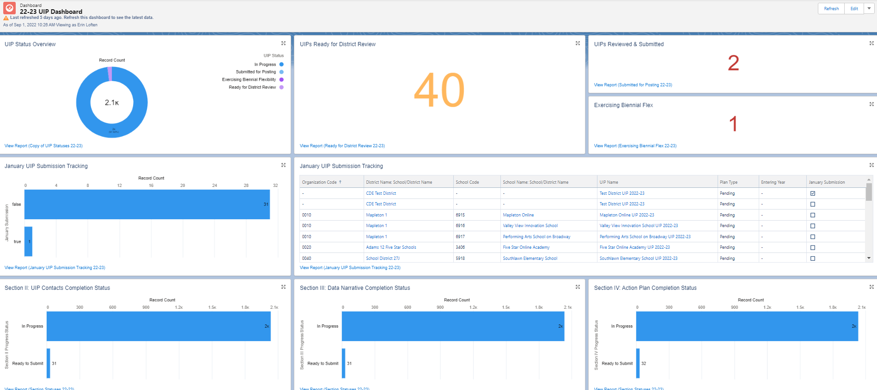
Data and Visualizations
Data:
Board Presentations
Growth - Cohort and Baseline 8/17
Performance Frameworks 9/16-17
State Level Results
SPFs/DPFs over time
Growth (CMAS, PSAT/SAT, ACCESS)
Participation
Matriculation
Visualization Tools:
Public School and District Dashboards
Dashboard embedded in UIP online system (R2R participation eligibility)
N of 1 (Small Systems)
Online UIP District User Dashboard and Reports
Ready for Review, Biennial, January, ESEA ID, etc.
Notes:
board presentation for context. You can see the state content results presentation here for the 17th. The presentation starts at 1:28:11. It may be helpful to view if the presenter notes are not enough. The growth presentation starts at 2:37:00.

Slide 31
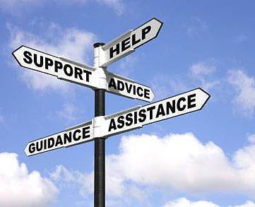
Accountability | Improvement Planning
Please contact our office for support and technical assistance
Accountability communications are posted on website, under “Announcements”
We can provide personalized assistance for your school and district accountability and support needs regarding:
School and District Performance Frameworks
Request to Reconsider Process
Alternative Education Campuses
Student Achievement and Growth
Data Literacy and Interpretation
Improvement Planning
http://www.cde.state.co.us/uip/uip_training

Slide 32
Contact Us
Accountability and Improvement Planning
Dan Jorgensen, PhD
Training/Technical Assistance
720.245.4532
Jorgensen_D@cde.state.co.us
Aislinn Walsh
Request to Reconsider/Accreditation
720.614.2151
Walsh_A@cde.state.co.us
Erin Loften
Training/Technical Assistance
720.475.0681
Loften_E@cde.state.co.us
Lisa Medler
Exec.Dir., Accountability and Continuous Improvement
P 303.866.6993 | C: 303.656.6619
medler_l@cde.state.co.us
General support:
accountability@ cde.state.co.us

