Slide 1
Technical Advisory Panel Meeting
May 15, 2025

Slide 2
Welcome & Introductions
Welcome from CDE
  The purpose of the TAP is to provide non‐binding technical recommendations to CDE regarding the Colorado Growth Model, state accountability, and other topics as needed.
Meeting Logistics:
  Non‐members, please add your Name/Affiliation to the chat box.
  Everyone please mute your sound.
  We ask all non‐TAP members to hold any comments until the end of the meeting. We do this to ensure we have sufficient time to address all meeting agenda items.
Introductions with Ryan Marks, TAP Chair

Slide 3
Agenda for Today
Welcome and Introductions | Information Item
AEC Follow Up | Information Item
TAP Chair Elections | Feedback Item
HB25-1278 Education Accountability System | Feedback Item
Small Systems Accountability Analysis | Information Item
Wrap-Up

Slide 4
Alternative Education Campus Follow Up
Aislinn Wales
Information Item

Slide 5
AEC Workgroup Updates - CDE Next Steps
Now: Optional measure data study looking at submitted data from districts
Now: CDE is making resource updates based on workgroup recommendations
Now: CDE is working on improved trainings and process improvements.
Mid May: A report based on workgroup recommendations will be presented to CDE Leadership, and the field
Early Fall: CDE will release a list of proposed measures for sunset/renorming
Early Fall: The new optional measure process will be released
Ongoing: CDE will elevate items noted as not within our scope of change to leadership
New
AEC Handbook
&
Calculation Guidance

Slide 6
TAP Chair Elections
Aislinn Wales & Ryan Marks
Feedback Item

Slide 7
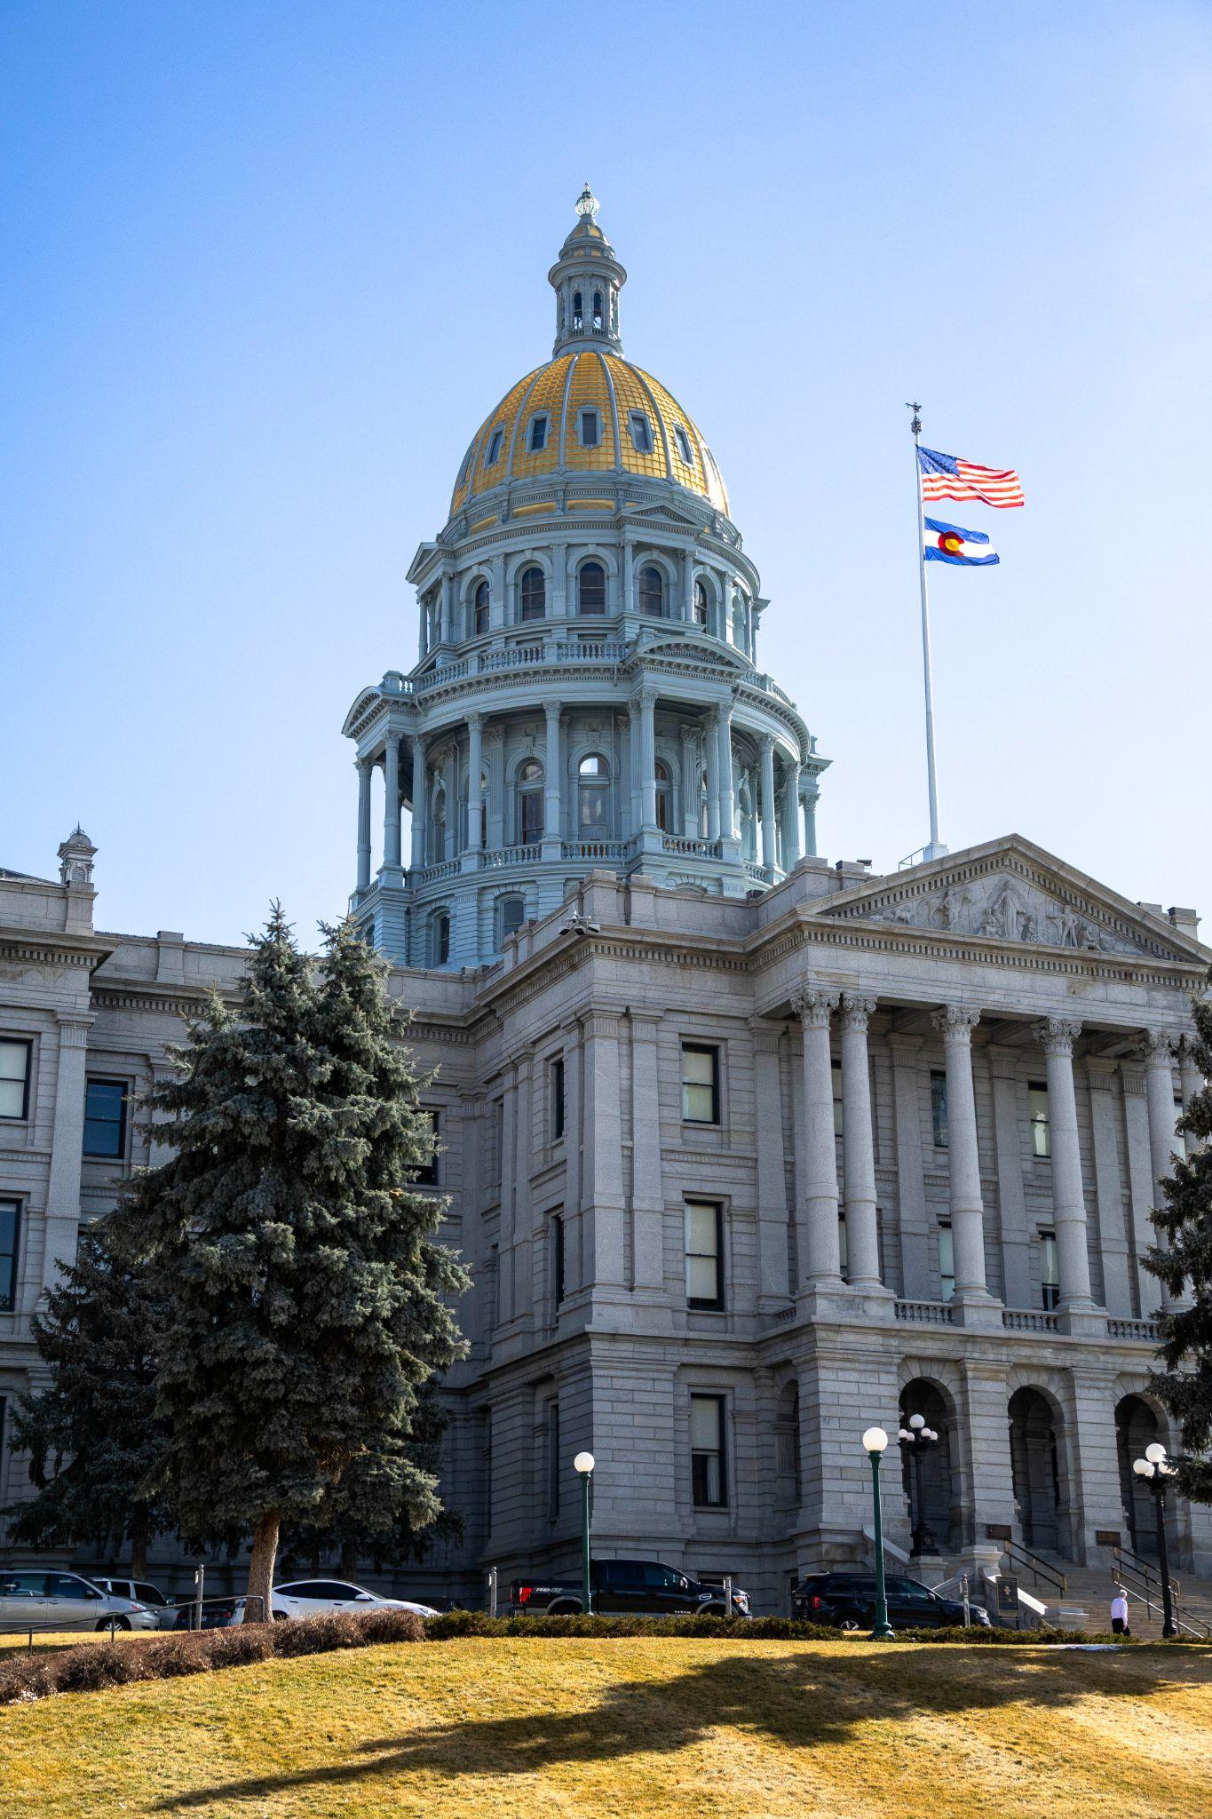
Thank you, Ryan!
We’re so grateful for your service as TAP Chair! Over the past two years, the TAP:
Wrote a statement to the state board about Higher Bar measures
Created TAP principles for the 1241 taskforce
Made recommendations and decisions concerning a variety of agenda items, including On Track Growth measures and reporting, the PWR indicator, PSAT/SAT assessments

Slide 8

Congratulations, Scott Weldon - our New TAP Chair!
TAP Chair will serve a 2-year term (2025-26 to 2026-27). In collaboration with the CDE facilitator, the TAP Chair will:
Call the meeting to order.
Announce the sequence of the agenda, including omissions or additions to the agenda (as needed).
Recognize panel members, staff, and visitors who are entitled to the floor.
Maintain decorum within the meeting.
Ensure that meetings follow Robert's Rules of Order (when necessary).
Respond to inquiries of members relating to parliamentary procedure factual information or business of the body.
Serve as official spokesperson for the TAP (as needed).
Declare meeting adjourned.
Perform other duties as delegated by CDE and the TAP.

Slide 9
HB25-1278 Education Accountability System
Lisa Medler
Feedback Item

Slide 10

2025 Bills Impacting Accountability
SB 25-315: Postsecondary & Workforce Readiness Programs. Creates a PWR funding model for start-up, innovation and sustainability funding. Adds PWR data collection report that will also be helpful to accountability data.
HB 25-1210: Data Reporting Requirements. Focus on UIP process, including developing a streamlined format, flexibility on the action plan, and centralized reporting to guide distribution of resources and supports.
HB 25-1167: Alternative Education Campuses. For AECs, priority funding on grants, expands eligibility for how some students’ ages are counted, directs CDE to publish an enrollment trends report and adds flexibility on enrollment fluctuations to retain AEC designation.
HB 25-1278: Education Accountability System. Covered in next section.

Slide 11
Updates on the Accountability Bill (HB 25-1247)
Policy Development Structures
State Legislature
State Board of Education
CDE Documentation and Guidance
Builds from the 1241 Task Force Recommendation Report (Nov 2024): https://www.cde.state.co.us/accountability/1241taskforcefinalreport
(May 2) Revised Bill: https://leg.colorado.gov/sites/default/files/documents/2025A/bills/2025a_1278_rev.pdf
(May 5) Passed on the Senate Consent Calendar and is headed to the Governor’s desk for signing
Final Fiscal Note will be published soon
Implications for State Board rules and CDE guidance

Slide 12
Note Capture
Feedback on topics
Add specific items as they are being described.
Early Resources/Events
(coming soon)
Fact Sheet on the accountability bill (including a timeline)
Webinars (June and September)
CASE Session on Accountability Updates
What else would be helpful?

Slide 13
Main Sections of the Accountability Bill (HB 25-1278) - 1 of 4
DRAFT
Theme Area | Highlights
State Assessments | Eliminates paper-pencil format for state assessments (except for accommodations) and the optional writing portion of SAT. CDE will provide guidance to LEAs on how to divide CMAS into smaller sections for students with disabilities who have an IEP or 504/plan Provides student count thresholds for when CMAS is translated into more languages Directs CDE to provide LEAs with state assessment results by June 1 or as soon as practicable
Framework Adjustments (by 2027) | Moves SAT to Achievement from PWR indicator Combines student groups, with disaggregated groups shared in public reporting Expands how students with disabilities are counted Adds criteria for districts to earn a Distinction rating

Slide 14
Main Sections of the Accountability Bill (HB 25-1278) - 2 of 4
DRAFT
Theme Area | Highlights
Frameworks - PWR Indicator | Adds a “college and career readiness before graduation” subindicator that is organized around the “big three” (i.e., postsecondary credit, industry-recognized credentials, work-based learning) Changes “matriculation” to “postsecondary progression” subindicator
Public Reporting | Directs CDE to study a single coherent state dashboard for state and local data (i.e., stakeholder engagement, cost estimates) Enhance user experience and functionality Adds new reports (e.g., PWR data, participation/non-participation for accountability purposes)

Slide 15
Main Sections of the Accountability Bill (HB 25-1278) - 3 of 4
DRAFT
Theme Area | HIghlights
Insufficient State Data (ISD) | Adds a corrective action plan when ISD is assigned for low participation Requires a meeting with the state board in Year 3
Continuous Improvement (inc accountability clock) | Universal Support: Directs CDE to provide guidance to local boards on how to review and monitor improvement plans. Proactive Support: Directs CDE to offer a process to identify and support schools prior to entering performance watch or early on the clock. Early on Clock: Directs CDE to offer ongoing support and feedback in Years 1 and 2. Late on Clock: Adds clarity and flexibility on a pathway plan. Adds another SBE-directed action that is comparable to or of comparable effect as existing options. Adds an evaluation of external managers.

Slide 16
Main Sections of the Accountability Bill (HB 25-1278) - 4 of 4
DRAFT
Theme Area | Highlights
Areas for Further Study | Formalizes the Accountability Work Group, including representative membership. TAP and AWG provide consultation on studies. Small Systems. Adds two related studies to examine (1) lowering student count thresholds for calculations and reporting and (2) volatility within the accountability for small systems. State Assessments. Study to provide recommendations on shortening assessment and implementing adaptive assessment technology.
Areas of Further Note | Resources not allocated for any of the “continuous improvement” work for at least FY 2025 and 2026. CDE is reviewing its current capacity. All of the 1241 Task Force’s recommendations were generally included in the bill, with the exception of some of the studies (e.g., new rating labels, accreditation system, awards, best practices)

Slide 17
TAP RECOMMENDATION
What clarifying questions do you have?
What theme areas are of particular interest (areas of opportunity and concern) to follow and potentially provide input?
What areas are missing and that may warrant future discussion?

Slide 18
Small Systems Accountability Analysis
Daniel Mangan
Feedback Item

Slide 19
Legislative Background
1241: Accountability, Accreditation, Student Performance, and Resource Inequity Task Force Report
CRS 22-11-212(1)(a) and (2)(a)
(1)(a) THE DEPARTMENT SHALL FACILITATE A STUDY, IN CONSULTATION WITH THE TECHNICAL ADVISORY PANEL, A COUNCIL THAT FOCUSES ON RURAL EDUCATION, THE ACCOUNTABILITY WORK GROUP DESCRIBED IN SECTION 22-11-202 (3), AND OTHER ADVISORY GROUPS WITH RELEVANT EXPERTISE, AND MAKE RECOMMENDATIONS ON LOWERING STUDENT COUNT THRESHOLDS ON ACCOUNTABILITY CALCULATIONS AND REPORTING….
(2)(a)...MAKE RECOMMENDATIONS ON ADDRESSING INHERENT VOLATILITY OF TEST SCORE MEASUREMENTS FOR LOCAL EDUCATION PROVIDERS WITH SMALL STUDENT POPULATIONS.
1241 Task Force Recommendations
#1: Lower student count thresholds for accountability calculations and reporting
#4: Explore best practices and monitor the accountability system to identify and reduce issues of volatility that impact schools and districts with small student populations

Slide 20
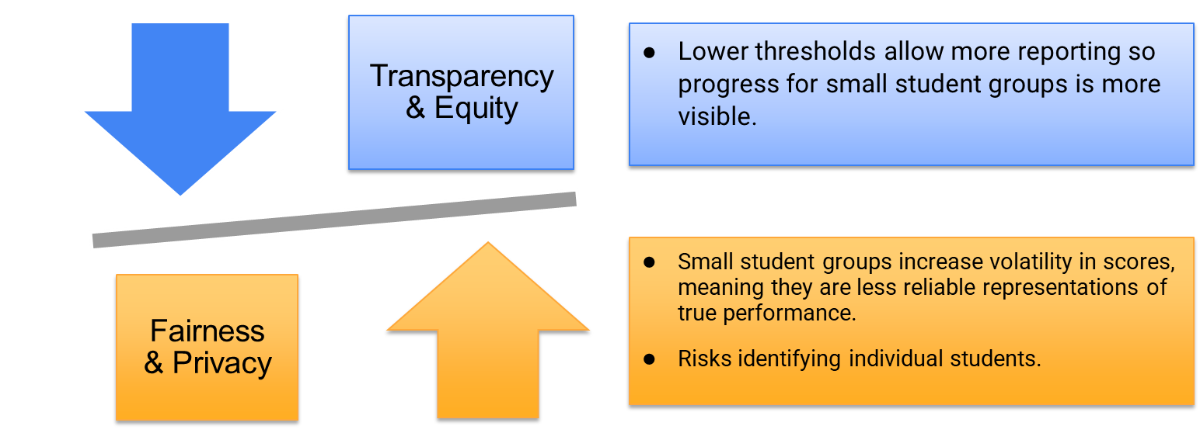
Why Minimum Group Size Matters

Slide 21
Federal ESSA Requirements
ESSA legislation requires states to design assessment systems that “enable results to be disaggregated within each State, local education agency, and school” by demographic subgroups.
However, “disaggregation shall not be required in the case of a State, local educational agency, or a school in which the number of students in a subgroup is insufficient to yield statistically reliable information or the results would reveal personally identifiable information about an individual student”
States balance these requirements by setting a “minimum n-size,” which indicates the minimum sample size needed for test score results from a subgroup to be reported and used for accountability purposes
1241 TF did not discuss federal ESSA requirements when considering minimum n-size thresholds.
Every Student Succeeds Act, 2015 Sec. 1111(b)(2)(B)(xi)

Slide 22
National Context
Three states average across three years for all accountability purposes (AK, WA, VT).
Of the states that use minimum N = 10 for accountability, three states aggregate across multiple years to reach the minimum N size (ND, SD, OK).
Only CO and NM use different minimum N sizes for growth and achievement.
(Alliance for Excellent Education, 2018)

Slide 23
Colorado Context
Colorado currently requires at least 16 students for achievement scores and 20 for growth scores to count in school ratings.
These requirements have been in place since 2010.
Two primary concerns w/ current requirements:
  When minimum n-sizes are not met, it is sometimes not possible to construct accountability ratings (ISD ratings) and/or disaggregated group results don’t get reported.
    This can undermine transparency/equity goals that rely on reporting data for all student groups
  When student counts are at or just above minimum n-sizes, aggregate test score results can be highly variable from year to year.
    This can be perceived as unfair, since ratings can be overly influenced by a small number of students and/or factors outside the control of schools/districts.
(Shear et al., 2025)

Slide 24
Research Questions
How would the number of schools with reportable achievement and growth data be impacted by changes to the minimum n-size requirements?
How would the reliability of school-level achievement and growth results be impacted by changes to the minimum n-size requirements?
Analytic Approach: We fit a two-level hierarchical linear model of student test scores nested within schools to estimate between- and within-school variance, compute intraclass correlations, and derive school-level reliability coefficients adjusted for each school’s sample size.

Slide 25
Population vs. Sampling Models
Cronbach (1997) specified two perspectives from which to consider a population of interest (POI).
Framework calculations are built fundamentally on a finite population model, but some proposed methodologies require a sampling (infinite population) approach.
Infinite population model is supported by AERA, APA, and NCME standards.
Finite Population (Population)
  POI = specific students in specific year
  Only measurement error contributes to uncertainty (no sampling error)
Infinite Population (Sample)
  POI = random sample of students from the population associated with school/group
  Sampling error and measurement error both contribute to uncertainty
Notes:
Note that fwks fundamentally built on finite population model, but for some of the methodologies being proposed we have to take more of a sampling approach.
Don’t imply that one is correct or not correct.

Slide 26
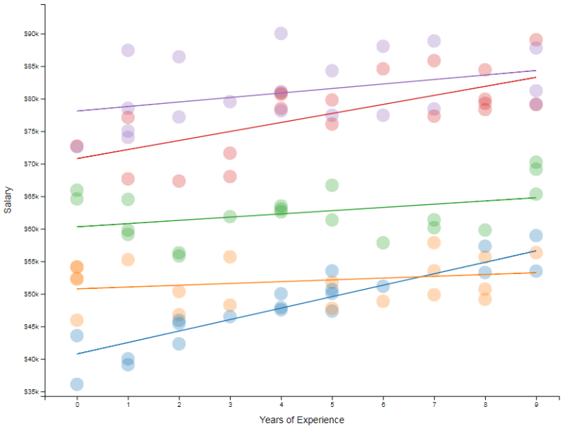
What is Hierarchical Linear Modeling (HLM)?
A regression framework for nested data (e.g., students nested in schools)
Partitions total variation into:
  Between-group (differences in school means)
  Within-group (student-level variation around each school mean)
Accounts for clustering so you get unbiased estimates of school effects
Notes:
Make HLM part footnote, focus on intuition that reliability has to do with how well you can differentiate true differences between groups. When groups differ a lot, even with noisy measures, then we can still differentiate. But if they don’t differ much then true differences are much harder to detect.
Make two slides, plus examples for ICC and Reliability

Slide 27
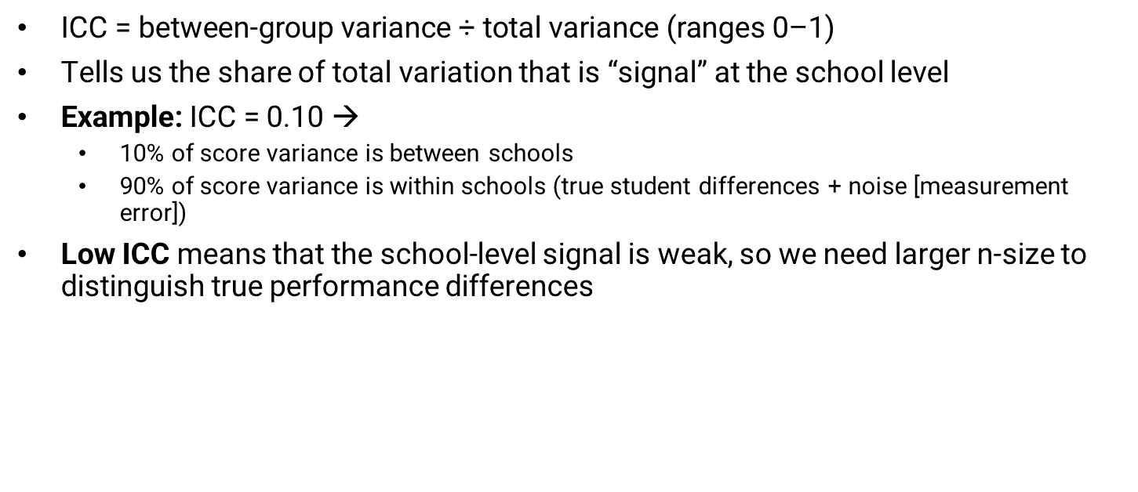
Intraclass Correlation (ICC) & Why It Matters
Notes:
Make HLM part footnote, focus on intuition that reliability has to do with how well you can differentiate true differences between groups. When groups differ a lot, even with noisy measures, then we can still differentiate. But if they don’t differ much then true differences are much harder to detect.
Make two slides, plus examples for ICC and Reliability

Slide 28
Reliability: True Signal vs. Random Noise
What is reliability?
  The share of a measure that reflects real differences (“signal”) rather than chance fluctuations (“noise”).
    Observed Score = True Score + Error
  For an individual’s test score, this is more straightforward because measurement error is the only contributor to statistical noise.
  For a group mean, we must also consider sampling error (in an infinite population model)
Key Drivers
  Variance partitioning (ICC): Higher ICC = more “signal” at group level
  Sample size:
    Larger n 🡪 noise cancels out, averages stabilize
    Smaller n 🡪 a few extreme scores can swing the mean
How it behaves:
  Reliability coefficients range from 0 to 1. A reliability of 0.80 is typically considered “good” and means that 80% of variance is from true differences while 20% is random error.
Why it matters:
  Very small schools/districts often have low reliability values, so interpreting their scores requires caution, aggregation, and/or model-based adjustments.
Notes:
Make HLM part footnote, focus on intuition that reliability has to do with how well you can differentiate true differences between groups. When groups differ a lot, even with noisy measures, then we can still differentiate. But if they don’t differ much then true differences are much harder to detect.
Make two slides, plus examples for ICC and Reliability

Slide 29
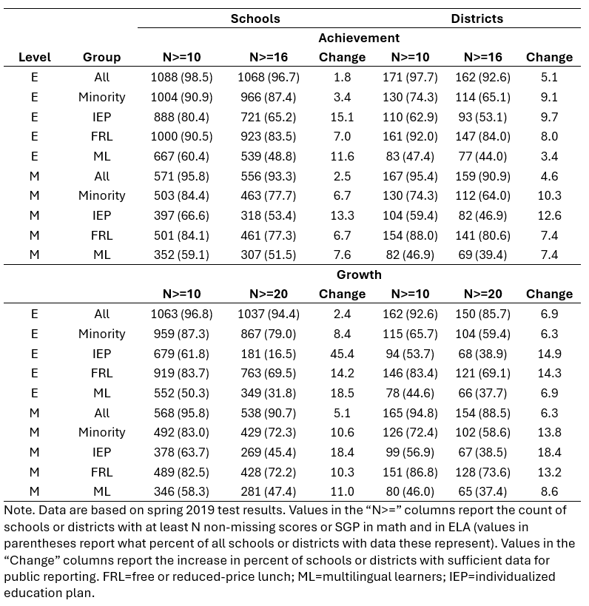
Results: Sample Size Impacts on Available Data (Achievement)
Reducing min-n threshold to 10 for achievement would increase reportable schools by 2-3% pts and districts by 4-5% pts.
For disaggregated groups, min-n of 10 results in reportable data in between 3% pts and 15% pts more schools.
Largest increases for ML and IEP students

Slide 30
Results: Sample Size Impacts on Available Data (Growth)
Reducing min-n threshold to 10 for growth would increase reportable schools by 2-5% pts and districts by 6-7% pts (slightly larger increases than ACH).
For disaggregated groups, min-n of 10 results in reportable data in between 6% and 45% pts more schools.
Increases for IEP students much larger than other groups

Slide 31
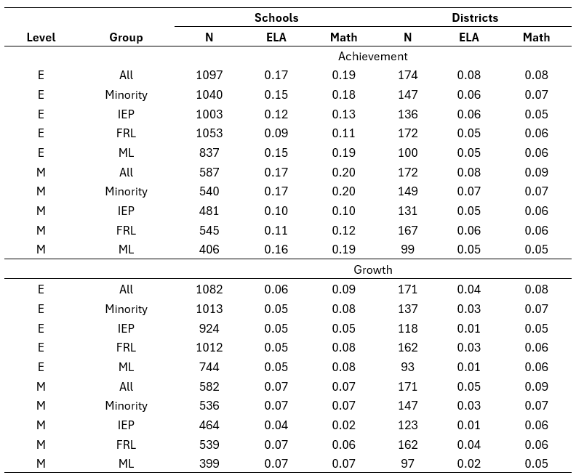
Estimated ICCs
For schools, average ICCs across subjects, groups, and grade levels are 0.15 for achievement and 0.06 for growth.
  Higher in math than ELA
For districts, average ICCs are 0.06 for achievement and 0.05 for growth.
  Consistent across subjects in middle school; higher in math for elementary
Disaggregated group ICCs follow similar patterns but are smaller overall.

Slide 32
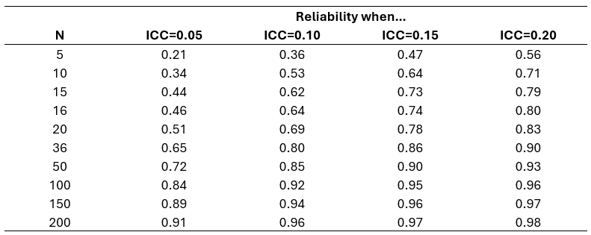
Implied Reliability by Sample Size & ICC
ICC values selected to represent range of values observed across different groups, units, and subjects.
Example: with highest school-level achievement ICC (0.20 in MS math) and a n size of 10 tested students, reliability of the mean is 0.71. Increases to 0.80 with 16 students.
These reliability estimates would be 0.34 and 0.46 for an ICC of 0.05, which is slightly below the average achievement ICC observed at the district level
The average reliability across all schools and districts will be higher than the values in this table, which are reported for specific, mostly small sample sizes

Slide 33
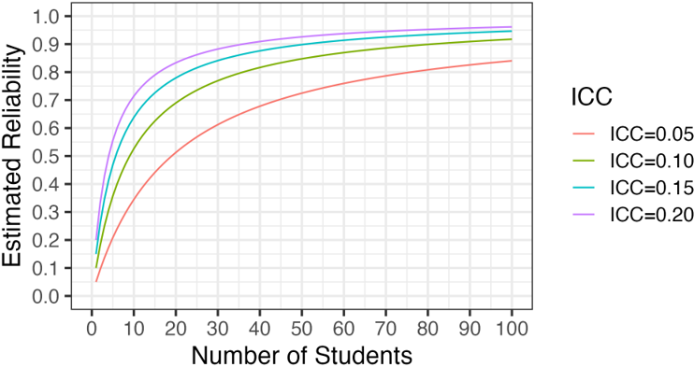
Implied Reliability by Sample Size & ICC, Cont’d
Lower ICCs mean more students are required for same level of reliability.
This highlights an important tradeoff:
  Example: lowering the min-n to 10 would require many more elementary schools to report growth data for IEP students.
  Average ICC for elementary growth = 0.05
  With ICC of 0.05 and n = 10, reliability is only 0.34.
  This means only 34% of variation in average SGPs is due to true differences in student performance.

Slide 34
Takeaways
Lowering minimum n-size thresholds will allow for increases of about 2-7 pct points in % of schools and districts reporting data for all students; slightly larger increases for disaggregated groups.
However, data for small groups will also be less reliable.
Whether increased reporting would be worth reduced reliability requires considering how results would be used to improve opportunities for students enrolled in these schools/districts.
Reliability of mean scale scores is higher than for average SGP for equivalent n sizes, which supports having higher minimum-n for growth.
Reliabilitiy calculations are a lower bound – most units will have larger n-sizes and thus higher reliability. There will also be variation from year to year, making it important to choose a proper baseline and make decisions about whether same thresholds are used across units and/or are allowed to vary.

Slide 35
Stabilization Study: Overview
Context: Annual achievement and growth scores can swing for smaller schools or disaggregated student groups, making year-to-year comparisons less reliable.
Methodology: Empirical Best Linear Prediction (EBLP) creates a stabilized average by combining current-year data with past years (and/or other subjects), weighting each source to minimize year-to-year volatility.
Optimal weights are specific to each school and shrink estimates towards long term means, bringing in some other information through fixed effects.
Key Idea:
When a school’s current sample is small (high noise), EBLP borrows strength from past data.
When current data are plentiful, EBLP relies mostly on that year’s results.
Notes:
Weighted average across years that tries to give true estimate of growth across scoools. For larger places gives more weight to current year. Done for all schools. And weights by statistically optimal weights intended to give best estimate of true growth. Optimal weights are specific to each school. Shrinks towards schools long term means and bring in other info through fixed effects. This model prioritizes given higher weight to prior year. Strict sample size weighting won’t do this. Mention used in California. Different than PA and NJ – they only used school level data. Also most of shrinkage in those models is across schools. This model has a little of that but bc of school level data is able to shrink to school means.

Slide 36
Stabilization Study: Overview, Cont’d.
Scope of Study: Apply EBLP to multi-year state data for both schools and districts—pooling across grades and subjects—to calculate hypothetical framework ratings. Produce impact data comparing these ratings against current outcomes to gauge the extent to which stability improves.
Method is currently being used in CA (n <=500) for reporting, though not yet for official ratings
Slightly different stabilization methods have been tried in PA and NJ.
In a simulation, Lockwood et al. (2022) found the method to reduce MSE vs. direct averages by 10 – 60% at the cost of minimal bias (<1 % of MSE).
For technical overview of methodology, see:
Lockwood, J. R., Castellano, K. E., & McCaffrey, D. F. (2022). Improving Accuracy and Stability of Aggregate Student Growth Measures Using Empirical Best Linear Prediction. Journal of Educational and Behavioral Statistics, 47(5), 544–575. https://doi.org/10.3102/10769986221101624
Notes:
Weighted average across years that tries to give true estimate of growth across scoools. For larger places gives more weight to current year. Done for all schools. And weights by statistically optimal weights intended to give best estimate of true growth. Optimal weights are specific to each school. Shrinks towards schools long term means and bring in other info through fixed effects. This model prioritizes given higher weight to prior year. Strict sample size weighting won’t do this. Mention used in California. Different than PA and NJ – they only used school level data. Also most of shrinkage in those models is across schools. This model has a little of that but bc of school level data is able to shrink to school means.

Slide 37
Next Steps
Reliability study to be published June 2025.
Stabilization study TBD (likely winter/spring 2026).
CDE will report results to TAP, AWG, Rural Council and recommended stakeholder groups.
Public release of information is estimated for spring 2026. Legislative report is due November 1, 2026.
Notes:
Reliability study early June from CADRE
Stabilization study TBD.

Slide 38
Feedback
What were the hopes for these small systems studies? What questions were stakeholders hoping to get answered? Are we on the right track?
Who should we ensure we are engaging during these studies? What advice do you have for communications on these studies?

Slide 39
Public Comments & Meeting Close
Aislinn Wales & Ryan Marks

Slide 40
Technical Advisory Panel
Meeting Summary
  Suggested future analysis
  TAP recommendations from this meeting
Public Comment
Close Meeting
  Next Scheduled Meeting: TBD
  Action Item: Complete the survey for next year’s meetings by May 30th - https://www.surveymonkey.com/r/TAP2526

