Slide 1
2023 State Accountability
July 18, 2023 - 1:00-2:00pm

Slide 2
Agenda
Purpose: Review the 2023 Performance Frameworks and Improvement Planning Expectations. Provide a preview of anticipated changes for the 2024 frameworks.
Background on the State Accountability System
Framework Changes from 2022 to 2023 Frameworks
Anticipated Framework Changes in 2024
Improvement Planning Changes
Accountability Resources and Supports

Slide 3
Background on the State Accountability System

Slide 4
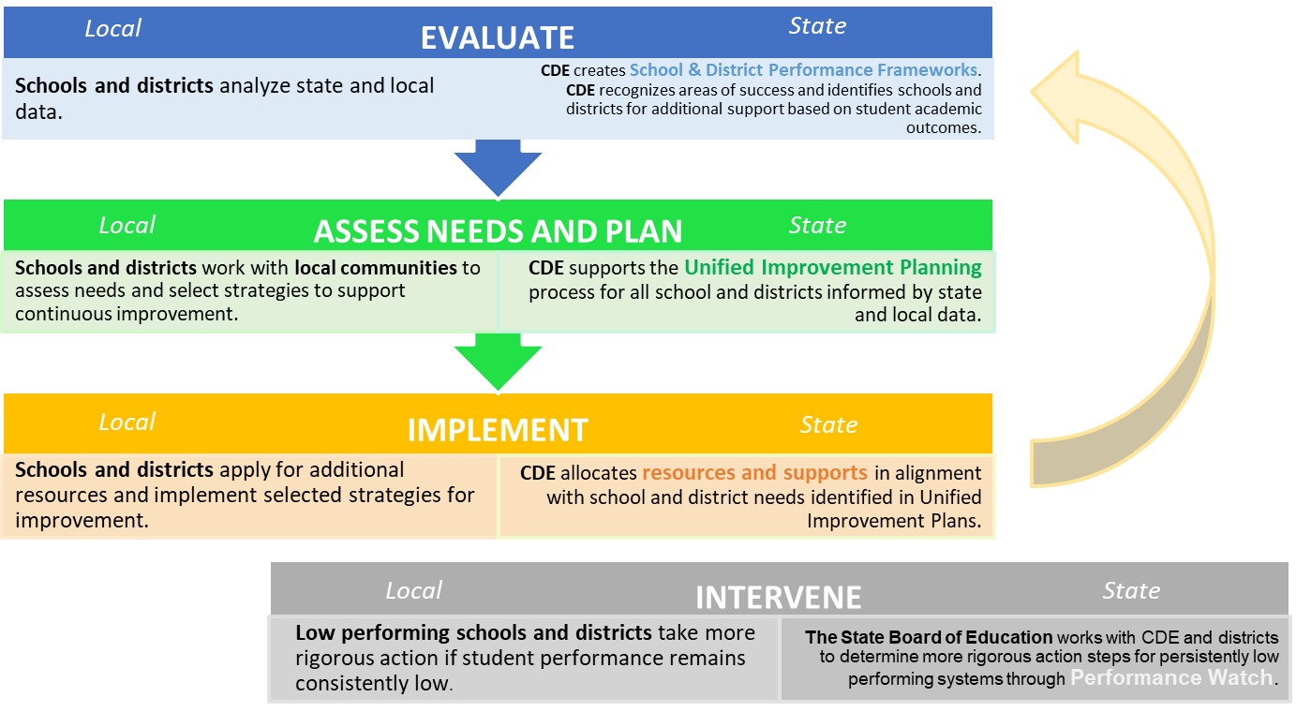
Accountability Theory of Action
Accreditation

Slide 5
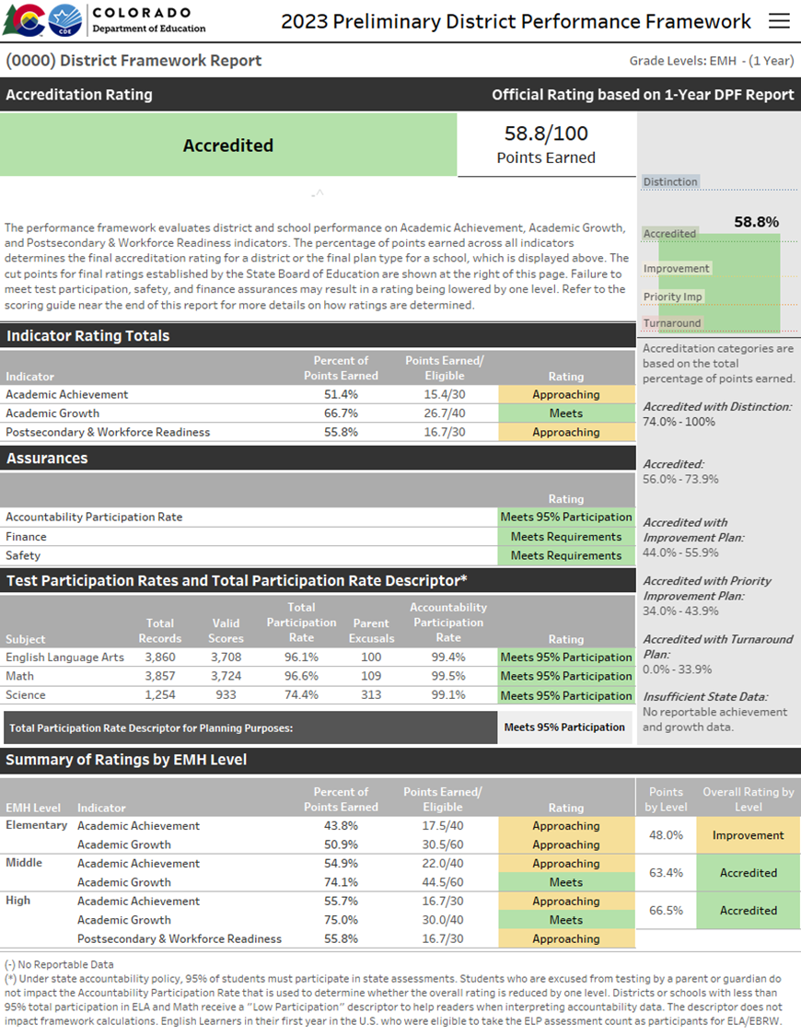
Performance Frameworks | Purpose
Provides a statewide comparison of student performance that highlights areas of success and areas for improvement.
Identify those districts and schools whose students are lowest-performing based on academic achievement, growth and postsecondary workforce readiness data, and direct state support and intervention appropriately.
Identify those districts and schools whose students are the highest-performing based on academic achievement, growth and postsecondary and workforce readiness data, recognize them and learn from their practices.

Slide 6
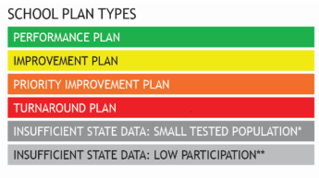
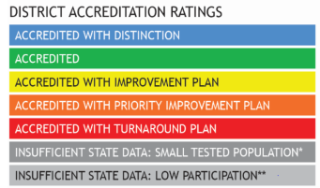
Performance Frameworks | Ratings and Explanatory Notes
Ratings
Descriptors
Meets Participation
Above 95% total participation rate in ELA and Math in 2023*
Low Participation
Below 95% total participation rate in ELA and Math in 2023*
Decreased Due to Participation
Below 95% accountability participation, once parent excuses are removed, in ELA and Math in 2023*
+
*Science participation is included for informational purposes only in 2022 and 2023.

Slide 7
Performance Frameworks | Indicators and Weighting
Performance Indicator | Performance Data | Weight
Academic Achievement | Mean scale score English language arts, math, and science assessments Overall and for disaggregated groups | 40% Elementary & Middle Schools 30% High Schools & Districts
Academic Growth | Median student growth percentile English language arts, mathematics and English language proficiency assessments English language proficiency On Track metric Overall and for disaggregated groups | 60% Elementary & Middle Schools 40% High Schools & Districts
Postsecondary and Workforce Readiness | SAT – Evidence-Based Reading & Writing and Mathematics Graduation Rate Dropout Rate Matriculation Rate (includes military enlistment) Industry credentials, included in Career and Technical Education and overall matriculation rates calculations Overall and for disaggregated groups (except for Matriculation rate) | 30% High Schools & Districts

Slide 8
Performance Watch Expectations
 | Criteria | Implications
On Clock | Earned a Priority Improvement or Turnaround plan type | Communication expectations Additional planning requirements and plan review by CDE Hearing with State Board after 5 years Eligible for supports and EASI grant funds
On Watch | Earned a Improvement or Performance plan type Previously on accountability clock for at least two consecutive years | UIP review by CDE Eligible for supports and EASI grant funds
On Hold | Received an Insufficient State Data Last available plan type was on clock | Communication expectations Additional planning requirements and UIP review by CDE Eligible for supports and EASI grant funds

Slide 9
School & District Accreditation Process
State Accredits Districts
August/September
CDE annually reviews performance through school and district performance frameworks
Districts Sign Accreditation Contracts
Districts Accredit their Schools
Districts officially sign off on final district accreditation ratings
Districts can submit a request to reconsider school plan types and district ratings
By December 31st
September/October

Slide 10
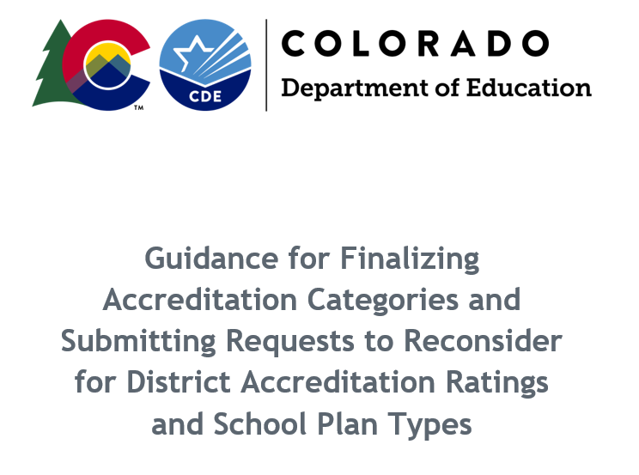
Accreditation Form| Purpose and Submission
The form’s purpose is to:
  Begin the process of finalizing school plan types and district accreditation ratings;
  Provide district updates for unique circumstances (e.g., new schools); &
  Indicate intent to pursue a request to reconsider.
Accreditation forms are due September 22 in the Accreditation Portal in the ACI/UIP online system, available to District Accountability Contacts.

Slide 11


Request to Reconsider | Purpose and Process
Request to reconsider is the district’s opportunity to request reconsideration of a school or district’s preliminary rating based on additional evidence.
  The state board adopted rules in 2022 that added an eligibility requirement of 90% total participation on state assessments. This requirement expires in 2023.
Request to reconsider is due October 16.
The Department will consider requests and review it based on criteria outlined in policy.
The state board will review and finalize CDE recommendations and approves school plan types.
All formally reviewed requests are public documents.
Approved 2022 Request Example
Preliminary Plan Type:
Body of Evidence request (using K-2 local data), approved by State Board of Education in December
Final Plan Type:

Slide 12
Changes from 2022 to 2023 Frameworks

Slide 13
High Level Changes
Clock progress resumes. Performance frameworks are no longer considered “transitional”.
“Decreased Due to Participation” requirement will be applied in 2023.
Total participation descriptor is moved from the overall rating in the frameworks but still on cover page for reference.
No longer calculating growth participation.
CDE will calculate single-year and multi-year frameworks (multi-year frameworks will represent two years of data) in 2023.
“English Learner” is now “Multilingual Learner” in the performance frameworks.
  Captures students that are Non-English Proficient (NEP), Limited English Proficient (LEP), and Fluent English Proficient (FEP) - Monitor Year 1, Monitor Year 2, Exited Year 1, & Exited Year 2.
Students who have “Exceeded 6-Year Clock” are reported in ELP On-Track Growth calculations.
For additional information, see the Summary Accountability and Improvement Planning Changes for 2023 fact sheet.

Slide 14
Clock Progress Resumes
In 2023, performance watch identifications (i.e., On Clock, On Watch, On Hold) will be applied once again -- meaning that sites may advance on the clock or begin the exiting process without using request to reconsider.
2022 Final Plan Type | 2023 Preliminary Plan Type | 2023 Final Plan Type | Notes
Improvement - Year 2 | Improvement - Year 2 On Watch | Improvement - Year 2 On Watch | May fully exit in 2024 if maintain Improvement or higher
Priority Improvement - Year 2 | Priority Improvement - Year 3 | Improvement - Year 2 On Watch (After approved request to reconsider)

Slide 15
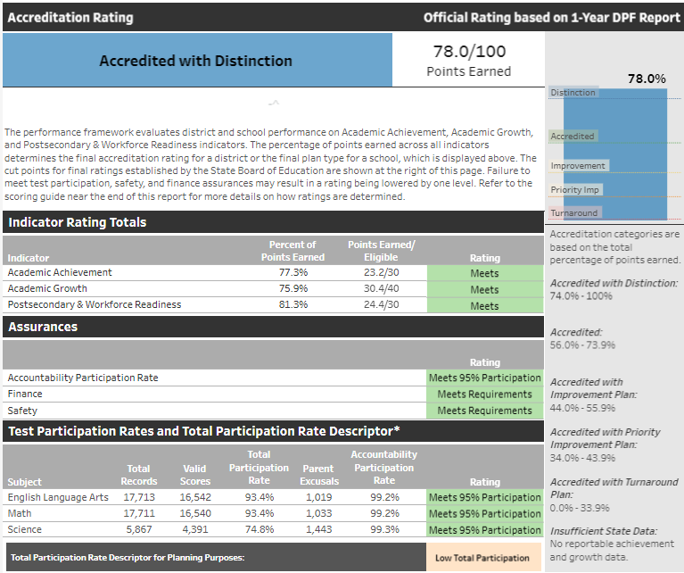
Participation Descriptor
Total participation descriptor is moving from the plan type in the top banner to a new row in the Test Participation Rates table.
Note: If a site does not meet the accountability participation rate in English language arts/math, then the plan type will still include the “Decreased Due to Participation” label.

Slide 16
Tentative Timeline for 2023 Accountability
Anticipated Timeframe | Activities/Actions
June 29 | Districts Receive ACCESS Growth Data
Early August | Districts Receive CMAS and P/SAT Growth Data; Performance Framework Source Data Files; UIP Data Dashboards available
August 16-17 (SBE Meeting) | Public Release of Colorado Growth Data Results; Alternative Education Campus (AEC) Designations Finalized
Late August | Preliminary Performance Frameworks Released to Districts. Public release 3 days later. ESSA Identifications Released to Districts.
Mid-September | AEC Performance Frameworks Released
September 22 | Accreditation Form Submissions Due
October 16 | Unified Improvement Plan (UIP) Submissions Due Final Request to Reconsider Materials Due (for participating districts)
November 8-9 (SBE Meeting) | District Accreditation Ratings & School Plan Types Finalized for Districts/Schools not participating in request to reconsider
December 13-14 (SBE Meeting) | District Accreditation Ratings & School Plan Types Finalized for Districts/Schools participating in request to reconsider
By December 31 | District Accreditation Contracts Due
January 16 | Eligible schools and districts (i.e., newly identified, request to reconsider) submit UIP for CDE review and posting
Late January | Informational reports released to districts with new measures (e.g., On-Track Growth, PWR higher bar, science achievement).

Slide 17
Anticipated Framework
Changes in 2024

Slide 18
2023 Informational Results for Schools and Districts
The official 2023 school and district performance frameworks are planned for release in fall 2023, and will include the same indicators and sub-indicators as published in 2022.
A supplemental set of framework results will be released for informational purposes in January 2024, which include:
  On-Track Growth indicator
  Higher Bar sub-indicators
  CMAS Science achievement and participation
2023
2024
Informational Release
Likely Included for Points
All: The On-Track Growth indicator, Higher Bar sub-indicators, and CMAS Science results will be shared for informational purposes following the release of official 2023 performance frameworks, likely in January 2024.
Elementary and middle schools: On-Track Growth will represent 10% of points on the frameworks.
High schools and districts: Higher Bar measures will count for points on the PWR indicator.
All: CMAS Science achievement and participation results will be factored into overall ratings.

Slide 19
On-Track Growth | Inclusion in the Framework
Required by Colorado’s educational accountability law, the On-Track Growth performance indicator addresses:
  Catch Up: Whether students scoring below grade level are catching up to grade-level expectations within two years.
  Keep Up: Whether students who are already meeting grade-level expectations are maintaining their performance for two years.
On-Track Growth will account for 10% of the total framework indicator points for elementary and middle schools
CDE, CADRE, and the TAP are investigating a methodology for high schools and districts. CDE will discuss options with the state board in the fall.
Elementary and Middle School Weighting
2016-2023
2024+
Growth
55%
Growth
60%
On Track 10%*
Achievement
40%
Achievement
35%
Notes:
The target equally pulls from both achievement and growth indicators—since it is a measure that uses each student’s achievement performance level and determines, based on their growth results from year-to-year, how long it will take for that student to either advance to the next performance level or maintain grade-level proficiency. This new measure is both an achievement and a growth measure and that is why On Track growth will pull from both.

Slide 20
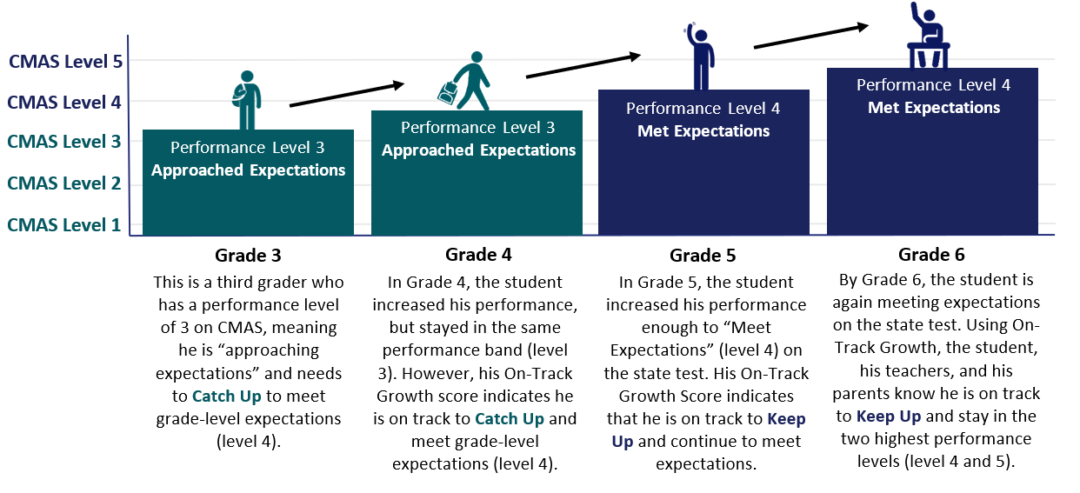
On-Track Growth | Student Example

Slide 21
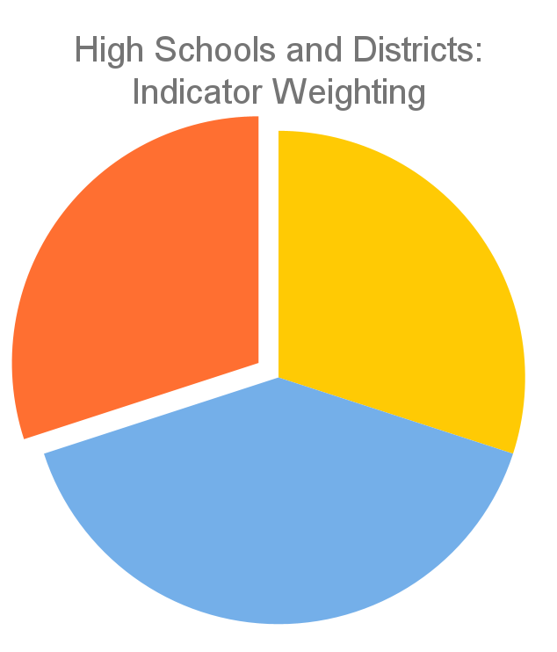
Higher Bar Sub-Indicators | Inclusion in the Framework
Currently, the postsecondary workforce readiness indicator consists of five sub-indicators (detailed in the image on the right)
TAP and CDE are working on developing points for two Higher Bar sub-indicators:
  Higher Bar for English Language Arts (ELA) and Math (S.B. 17-272): Measures the proportion of graduating students attaining a higher level of achievement (as defined by the state board) in both ELA and math on certain graduation guidelines measures
  Higher Bar for Non-ELA and Non-Math (H.B. 18-1019): Measures the proportion of graduating students attaining similar high expectations in AP, IB, and/or CE non-ELA and non-math courses.
PWR 30%
Achievement
30%
Growth
40%
Current PWR Indicator: Points by Sub-Indicator & Level
SAT EBRW (8 points): Mean Scale Score [All Students (4) & Disaggregated (1 each)]
SAT Math (8 points): Mean Scale Score [All Students (4) & Disaggregated (1 each)]
Dropout (16 points): Rate [All Students (8) & Disaggregated (2 each)]
Matriculation (4 points): Rate [All Students (4)]
Graduation (16 points): Rate [All Students (8) & Disaggregated (2 each)]

Slide 22
CMAS Science | Inclusion in the Framework
Students in grades 5, 8, & 11 take the CMAS Science assessment
The assessment reflected 2020 Colorado Academic Standards for the first time in 2022 and were not factored into transitional frameworks
Science results will be re-introduced in the informational reports (January 2024) and then for points in the 2024 frameworks
  Achievement and participation results will not be factored into overall 2023 plan types
  School and district 2023 plan types will only be lowered for participation if both English language arts and math accountability participation rates are below 95%

Slide 23
Draft Timeline for Implementation
Anticipated Framework Changes
Indicator Weights
2023 Frameworks
Elementary and Middle Schools: On-Track Growth and Science shared for informational purposes
High Schools/Districts: Higher Bar and Science shared for informational purposes
Growth
40%
Growth
60%
Achievement
30%
Achievement
40%
PWR
30%
ES & MS
HS & Dist
2024 Frameworks
Elementary and Middle Schools: On-Track included for points
High Schools/Districts: Higher Bar included for points, On-Track Growth shared for informational purposes
All: CMAS Science included for points
Growth
55%
Growth
40%
Achievement
30%
On Track 10%
Achievement
35%
PWR
30%
ES & MS
HS & Dist
2025 Frameworks
High Schools/Districts: On-Track Growth included for points
Growth
55%
Growth
On Track
On Track 10%
Achievement
Achievement
35%
PWR
ES & MS
HS & Dist*
*Weighting has not been recommended by TAP, nor approved by the state board

Slide 24
Improvement Planning Changes

Slide 25
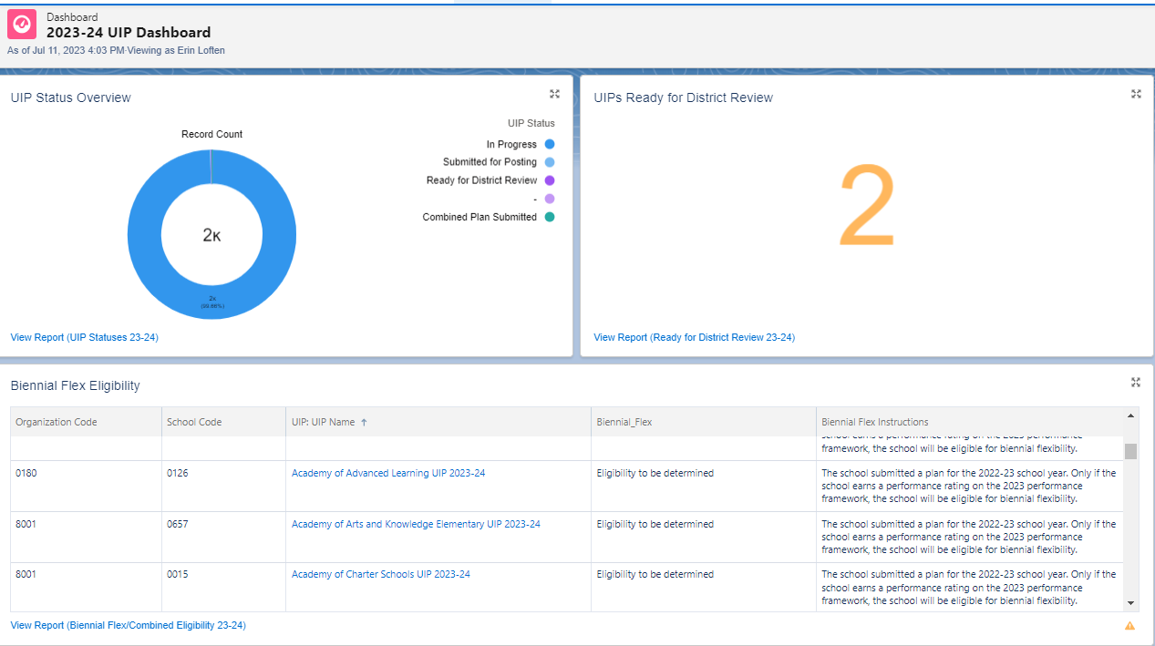
Improvement Planning Dashboards
Available to district level users
Visuals with reports available for each area (biennial flexibility, planning expectations, UIP progress status etc.
Exportable for collaboration (e.g. Title I coordination)

Slide 26
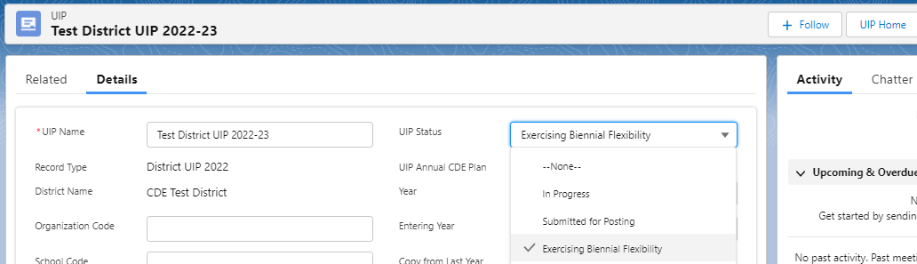
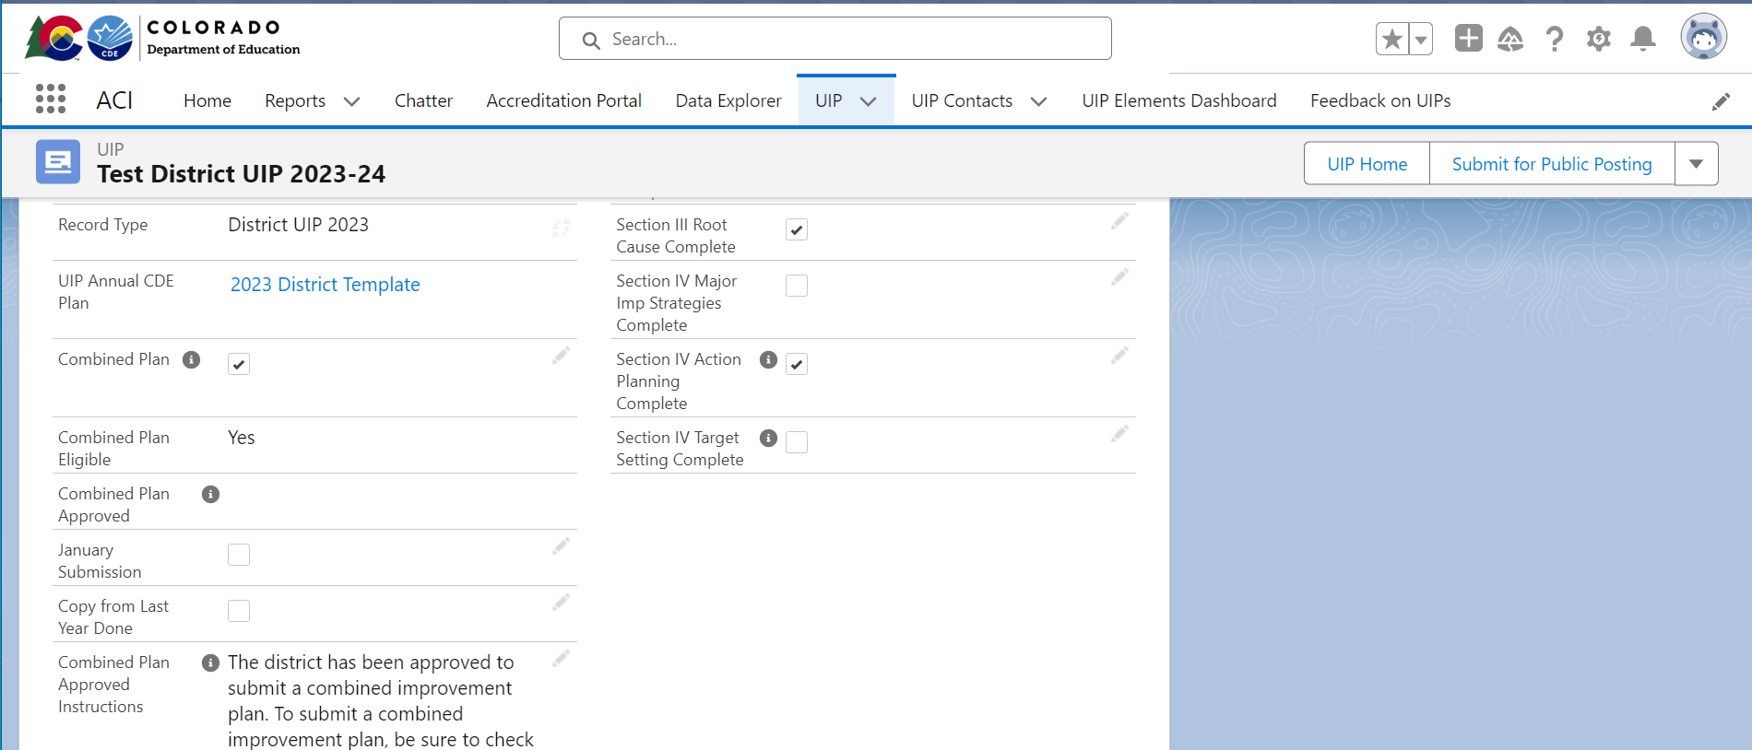
District Selection of Flexibilities
Districts select which flexibilities they will be choosing for UIP Submission (Combined, Biennial, January).
These selections will present on the landing page of the school’s UIP. (New!)
Note: these will not show eligibility for Biennial/January until after performance framework ratings are released.

Slide 27
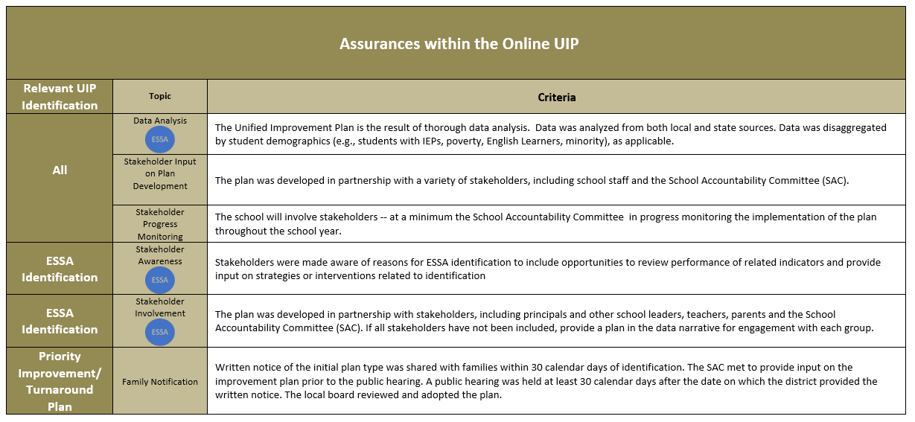
Some Expectations Captured as Assurances
Will be customized within the online system based on school specific information.
The school has responsibility for ensuring completion of activities associated with these expectations and may be asked to share artifacts as a part of a monitoring process.

Slide 28
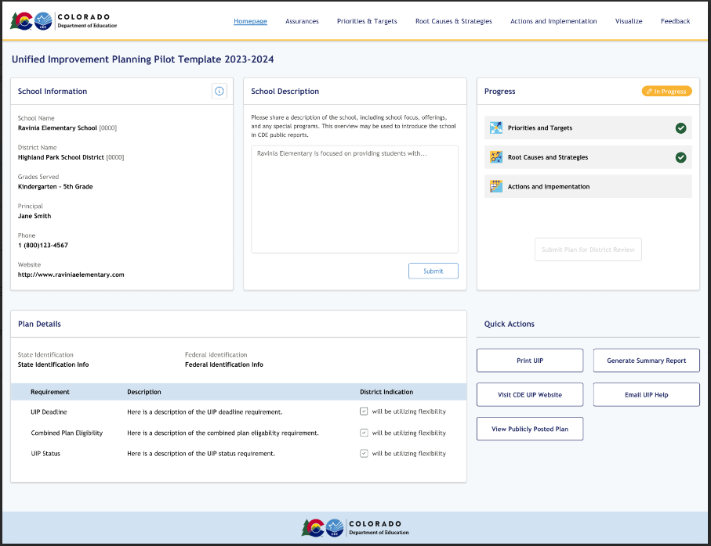
UIP Template Pilot
A new pilot template is underway, with a small scale launch in fall of 2023.
Goals for pilot include streamlined entry, more clarity for how meet expectations.
Additional information will be available in early 2024 for more broad participation/usage.

Slide 29

Math Act- Planning Requirements
New requirements with the Math Act (HB 23-1231) for those districts and schools with Improvement, Priority Improvement and Turnaround ratings:
Action Planning- identify strategies to address the needs of students who are below grade level or struggling in mathematics
Target Setting- set or revise, as appropriate, ambitious but attainable targets that the public school shall attain in reducing the number of students who are below grade level or struggling in mathematics

Slide 30
Accountability Resources and Supports

Slide 31
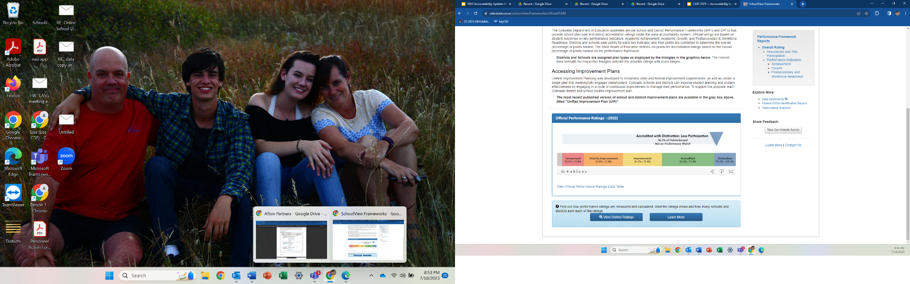
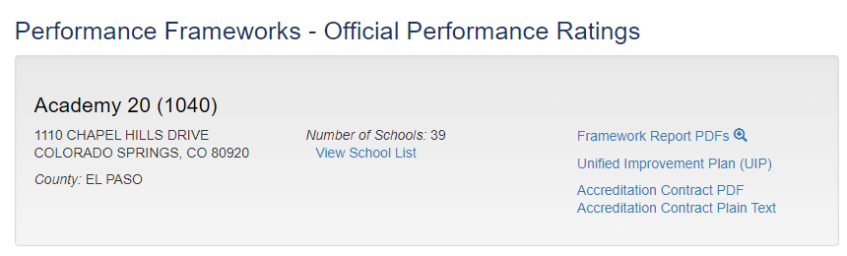
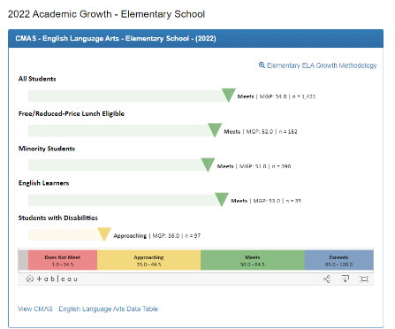
Performance Tools and Visualizations
Online Frameworks
CDE has launched an interactive version of the frameworks aimed at the public. Users see high levels reports initially and then can dig into accountability data more deeply. There are links to the framework pdf reports, the site’s UIP and the district’s accreditation contract.
Notes:
Google Doc Facilitator Notes

Slide 32
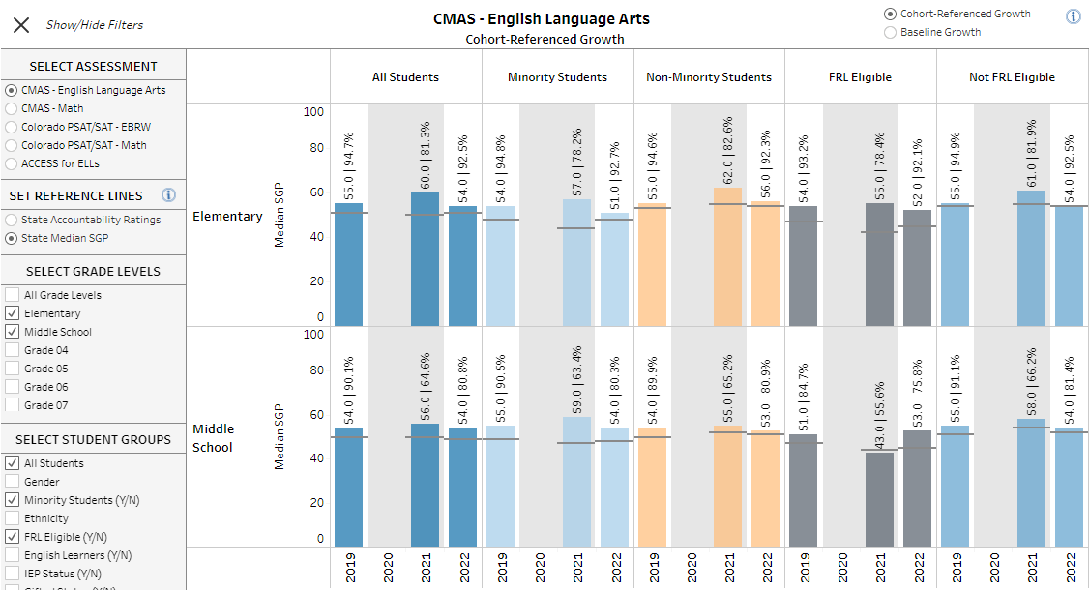
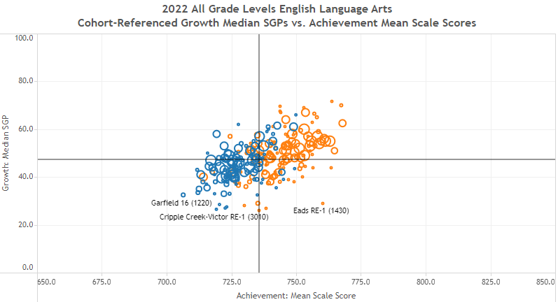
Performance Tools and Visualizations Continued
District and School Dashboard
Data Explorer Tool
Includes updated enrollment, demographics, achievement, growth, and postsecondary visualizations to support improvement planning efforts.
Includes updated achievement, growth, and postsecondary metrics that can also be downloaded into Excel files for additional analysis.
Notes:
Google Doc Facilitator Notes

Slide 33
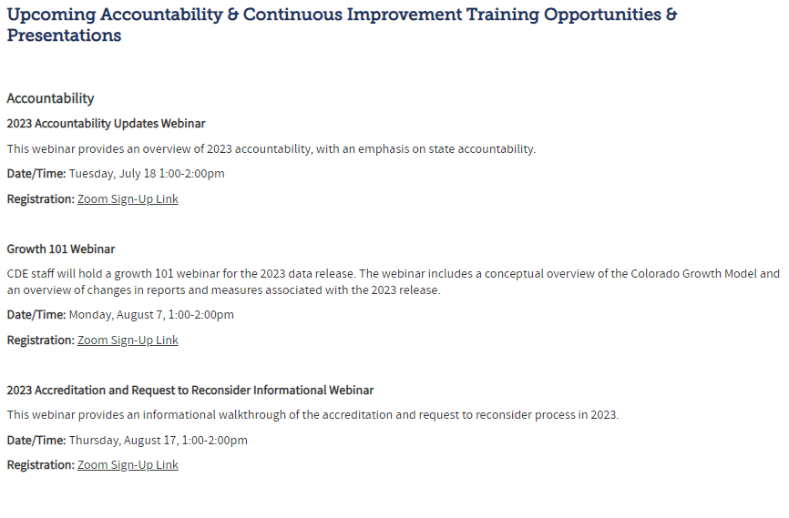
Training Opportunities
New website
Growth 101 Webinar on 8/7: Link to Register
Accreditation & Request to Reconsider Webinar on 8/17: Link to Register
District Accountability Committees - District Administrator Networking on 9/7: Link to Register
In-Person Regional UIP Training: Coming this fall
For more, go to: https://www.cde.state.co.us/accountability/accountabilitytrainingtechnicalassistance

Slide 34
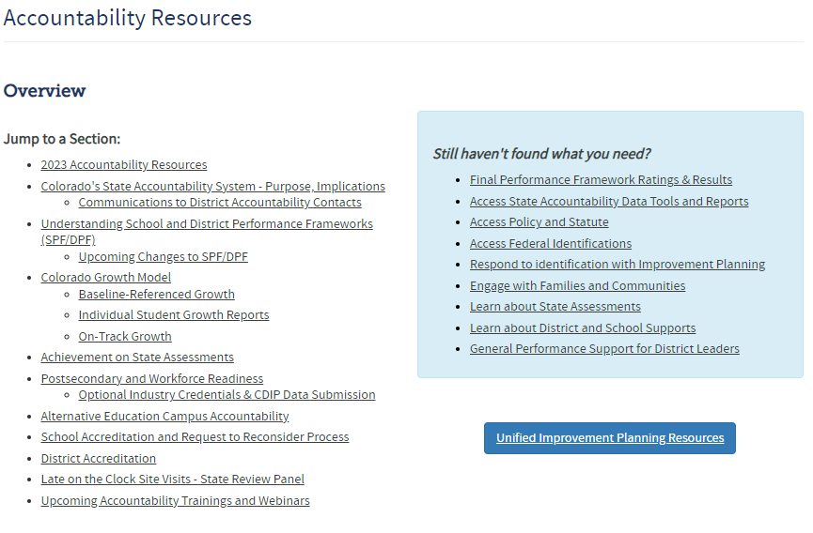
Resources
New website
Anticipated Framework Changes: https://www.cde.state.co.us/accountability/anticipatedframeworkchanges
Participation and Accountability Guide: https://www.cde.state.co.us/accountability/participationandaccountabilityguide-0
Task Force to Study K-12 Accountability: https://www.cde.state.co.us/accountability/accountability-task-force
For more, go to: https://www.cde.state.co.us/accountability/accountability-resources

Slide 35
Thank you!

