Slide 1
Colorado Transitional Accountability: Overview & Updates for 2022-23 June 29, 2022

Slide 2
Agenda
Overview of Accountability policy process
Overview of School and District Accountability for 2022-23
Transitional Frameworks
Request to Reconsider
Key distinctions for Accountability for 2022-23
Timeline
Anticipated Impacts
Resources

Slide 3
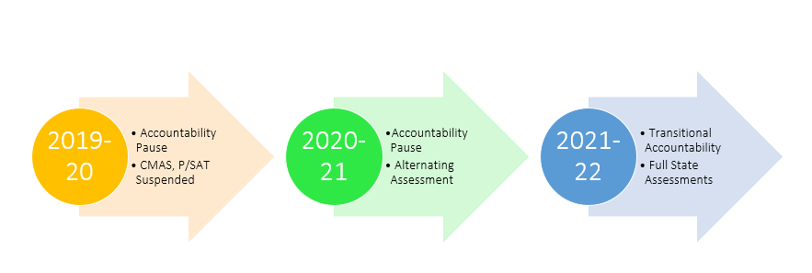
Timeline

Slide 4
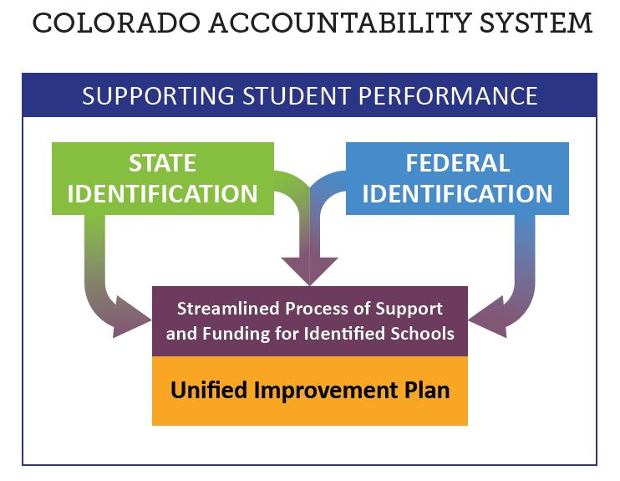
Identifications
Both state and federal accountability identifications will occur in 2022.
The U.S. Department of Education has approved the state’s waiver to make some adjustments to the process in light of the two-year pause. Changes are described on the website for the ESSA plan.
This webinar will primarily focus on implications of state policy.

Slide 5
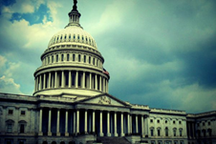
SB 22-137 - Transition Back to Standard K-12 Accountability
Restarts framework calculations for fall 2022 using 2019 statewide performance indicator targets.
Addition of growth participation rate to framework reports.
Accreditation and plan type ratings will be assigned, but clock status will not automatically advance (on or off).
Change in clock status may be approved through request to reconsider process, and opens request to reconsider process back up more broadly.
Clarification that State Board may take into consideration the 2022-2023 plan type for schools and districts (currently 12 schools and 2 districts) with directed action.
Expands the School Transformation grant (currently embedded with EASI grant) to districts with Improvement plan type.
SB 22-137

Slide 6
Draft Timeline for 2022 State Accountability
Timeline | Activities
March | CDE gathered stakeholder input CDE drafted proposed accountability rules
April | Accountability legislation is passed Noticed accountability rules at SBE meeting (April 13)
May | Public comment on proposed rules
June | State board voted to adopt amended rules (June 16)
Late Aug - Sept | Preliminary performance frameworks released Request to reconsider process begins
Nov - Dec | State board votes on CDE’s recommendations, including request to reconsider process

Slide 7
2022 Key Distinctions
Notes:
Section Lead: Dan

Slide 8
Overview of Adjustments to Educational Accountability
The 2022 changes are based on statutory requirements and technical considerations.
Changes have been informed by CDE analysis and input from various stakeholder groups (e.g., Accountability Work Group, the Technical Advisory Panel for Longitudinal Growth) and the Colorado State Board of Education.
CDE annually produces a description of changes and other resources that identifies each change made to the performance frameworks along with the rationale for the changes.

Slide 9
Transitional Frameworks

Slide 10
Plans for 2022 Transitional Framework Calculations
Description | Status
Plan type, performance indicator, sub-indicator cut scores | Same as 2019. CDE will not be able to calculate 3-year frameworks.
Achievement Results | Available for CMAS/CoAlt ELA & Math - Grades 3-8, PSAT/SAT/CoAlt EBRW & Math - Grades 9-11. No CMAS Science results.
Participation Rates | Accountability participation still calculated. New addition of growth participation rate for information purposes. Science participation included for informational purposes only.
Growth Data | 2021 and 2022 data used with traditional cohort-referenced approach. Available for CMAS ELA (grades 4, 6, 8), CMAS Math (grades 5 & 7), PSAT/SAT EBRW (grades 10 & 11), PSAT/SAT Math (grades 9 - 11).
Notes:
CMAS/CoAlt = Colorado Measures of Academic Success and Colorado Alternate Assessments
ELA = English Language Arts
EBRW = Evidence-Based Reading and Writing
TAP = Technical Advisory Panel

Slide 11
Plans for 2022 Transitional Framework Calculations (cont)
Description | Status
Resume ELP cohort-referenced MGP and On Track Growth | MGP and On-Track growth will be included; On-Track will be re-normed as previously planned.
PWR Data | Same as 2019 plus addition of military enlistment in matriculation; “higher bar” and IB/AP/CE postponed until 2023.
Sub-Indicator calculations | Same calculations for student groups as in 2019.
Insufficient State Data rating | Automatically assigned for schools/districts with less than 25% total participation in both reading and math, or if not enough data for public reporting in one or more performance indicators.
Preliminary Frameworks Timeline | August 24, 2022; Final frameworks published in November/ December 2022.
Notes:
ELP = English language proficiency
PWR = Postsecondary and Workforce Readiness
Higher Bar and IB/AP/CE = References to additional PWR measures for a higher bar for graduation from SB 18-012 and the inclusion of International Baccalaureate, Advance Placement and Concurrent Enrollment data in content areas other than math and ELA from HB 18-1019.

Slide 12
2022 Educational Accountability Revisions:
AECs
AECs are impacted by the same changes to performance frameworks previously described.
Selection of Measures process was available for AECs to submit optional local data for use on the 2022 AEC school performance framework.
Attendance and truancy measures will be removed from the 2022 performance frameworks.
“Insufficient State Data” may be assigned to AECs in 2022.
May participate in request to reconsider this year.
Notes:
1019: B for CE, 3+ for AP, 4+ for IB

Slide 13
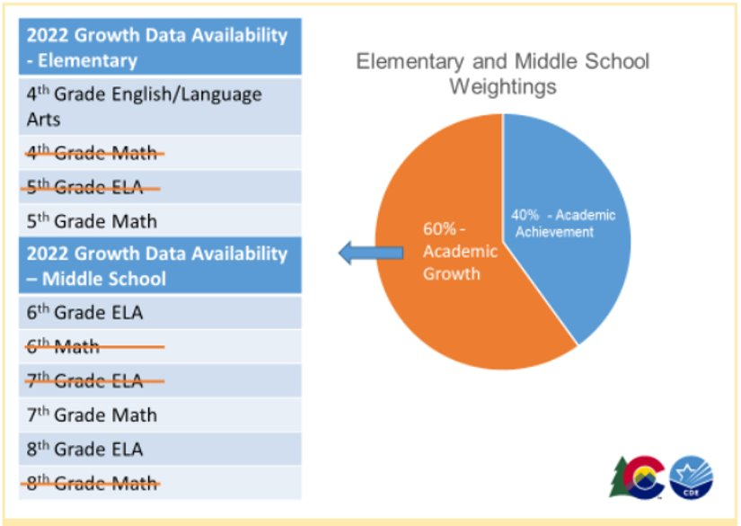
Growth Availability- Elementary/Middle

Slide 14
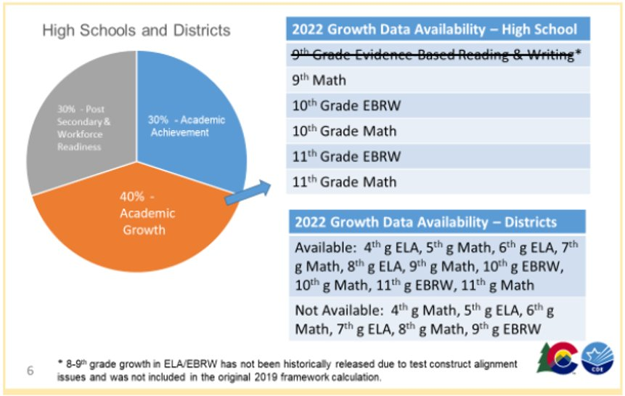
Growth Availability- High Schools

Slide 15
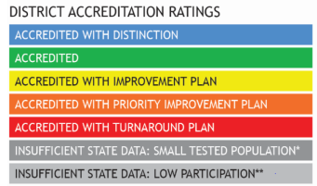
School and District Transitional Framework Ratings
Descriptors
Meets Participation
Above 95% total participation rate in 2 or more content areas
Low Participation
Below 95% total participation rate in 2 or more content areas
Decreased Due to Participation
Below 95% accountability participation, once parent excuses are removed, in 2 or more content areas
Ratings
+

Slide 16
Request to Reconsider

Slide 17
2022 Request to Reconsider Process
Request to reconsider is the district’s opportunity to request reconsideration of a school or district’s preliminary plan type based on additional evidence.
The board adopted rules that reflect an eligibility requirement of 90% total participation on state assessments for 2022.
Request to reconsider becomes the avenue for schools/district to adjust clock years (e.g. exit Performance Watch, move to On Watch) in 2022.
Notes:
Sites may use request to reconsider to move to “On Watch” or fully exit the accountability clock if they meet certain conditions.
Because of the 90% total participation rate eligibility requirement, certain historical practices (e.g., ability to request Insufficient State Data with less than 85% participation rate if the district or school is able to demonstrate that data is not representative) will not be available.

Slide 18
Background on Participation in Frameworks
Total participation parent excusals are counted as non-participants (i.e., they are included in the denominator)
Accountability participation parent excusals are counted as participants (i.e., they are not included in the denominator)
These ratings reflect whether accountability participation rates meet or exceed 95%.
Notes:
Total participation includes all students for all content areas (i.e., reading/EBRW and math in 2022) in the base. Parent excusals are counted as non-participants.
This is different than the accountability participation rate (i.e., parent excusals are counted as participants).

Slide 19
R2R Condition/ Pathway | Description to participate in 2022 R2R schools/districts are required to have 90% total participation on state assessments
Expedited Clock Adjustment* | For schools and districts on the clock or on watch, if state data demonstrates 90% total participation and a rating of Improvement or higher, the district will be notified of their eligibility for an expedited recommendation to change the school/district clock status. Additional evidence not needed. District needs to confirm clock adjustments using the accreditation form.
Impact of Alternative Education Campuses* | Districts may request the removal of AEC results from overall DPF rating calculation, as long as all AECs have earned Performance ratings in the current year. Districts with only AECs may elect to use the AEC framework rating as the district accreditation rating.
Districts with a single school* | Districts with a single school may elect to use the calculated SPF rating as the district accreditation rating.
Body of Evidence | School/district may provide supplemental evidence of different performance than preliminary state assignment. Need 95% total participation on local assessments (nationally normed).
Extenuating Circumstances | School/district with extenuating circumstances (i.e., “Act of God”) may submit a request based on conditions that impacted the state assessment administration window. This is part of the Body of Evidence condition.
Accountability Participation Impact | Districts and schools that had their rating “decreased due to participation” by not meeting the 95% accountability participation rate in two or more content areas may make a request if the requirement was not met due to reasons other than parent refusals (e.g., test misadministrations) or due to issues with N counts for smaller systems.
Districts with a closed school | Districts with Priority Improvement or Turnaround Plan types that have closed a school due to low performance may request a recalculated DPF with the results of the closed school removed.
*CDE will inform districts on their eligibility for this condition.

Slide 20
2022 Request to Reconsider Timeline
Preliminary Frameworks Released for AECs
AEC school plan types are released.
Final Request Materials Due
Final request materials (e.g., district narrative, local data) are due.
Aug 24
Sept 15
Dec 14-15
Sept 12
Oct 17
Preliminary Frameworks Released for Non-AECs
School and district plan types are released.
School Accreditation & Request to Reconsider Form Submissions Due
To initiate the process, the accountability contact will need to “disagree” with the preliminary plan type and/or clock status using the Accreditation and Request to Reconsider form in the Accreditation portal in the UIP online system.
District and School Plan Types Finalized during the State Board Meeting
For districts and schools going through request to reconsider, plan types will be considered final after the state board meeting.

Slide 21
2022 Request to Reconsider Support
Informational Webinar: August 15th at 1pm, click here to register
Office Hours: Begins Wednesday August 17 and will be held from 2-4pm every Wednesday and Thursday until the process concludes, click here to register
General Contact: Aislinn Walsh, walsh_a@cde.state.co.us or (720) 614-2151

Slide 22
Anticipated Impacts

Slide 23
Implications for All Districts and Schools - Not on Performance Watch
Theme | Description | Districts may need to anticipate…
Pandemic Context | Variability across state of remote and hybrid instruction, and impact on student learning/performance on state assessments​ | Greater need for communication and context building for staff and public
Cohort- Referenced Growth | Score distributions will likely look closer to historical results. Note: Baseline-Referenced Growth available later in fall. | Potential for misinterpretation of data as a signal of greater pandemic recovery than it is
Targets/ Cut- Scores | Same as from 2019, so some performance indicators may seem lower | Preparing staff and public for change in trajectory since 2019. State trends may be helpful in telling this story.
ISD Plan Types (Not previously on performance watch) | No 3-Year Frameworks, lower participation rates and missing data will lead to more ISD assignments. | Smaller systems and sites with lower participation rates should understand implications (e.g., UIP and accreditation contract due annually).

Slide 24
Implications for Performance Watch
Performance Watch
Accountability Clock
Unique to 2022
Priority Improvement/ Turnaround
Year 0
Priority Improvement or Turnaround
Year 1+
Performance/ Improvement
On Watch
Year 2+
Priority Improvement/ Turnaround with State Board Action
Year 5+

Slide 25
Implications for Districts and Schools on Performance Watch
Theme | Description | Districts may need to anticipate…
Clock Pause | Clock will not automatically advance (on or off). Sites must use R2R to adjust years on clock. | New 90% participation threshold for R2R and the need to manage expectations.
Newly Identified on Performance Watch | New schools can receive a PI or T plan type. Many requirements follow up the plan type, not years on clock. | Exploring new supports, grants and flexibility (e.g., UIP timeline).
ISD Plan Types (previously on performance watch) | Previous years on performance watch remain with the plan type. Associated requirements stay in continue. | Building understanding with staff and community, and continuing to use supports.

Slide 26
Timeline

Slide 27
Key Dates for 2022
Anticipated Timeframe | Activities/Actions
June 24 | Districts Receive ACCESS Growth Data
Early August | Districts Receive CMAS and P/SAT Growth Data
August 16/17 (SBE Meeting) | Public Release of Colorado Growth Data Results
August 24 | Preliminary Performance Frameworks Released to Districts
End of August | ESEA Identifications Released to Districts
September 15 | School Accreditation & Request to Reconsider Form Submissions Due
October 17 | Unified Improvement Plan Submissions Due For Districts/Schools going through request to reconsider, final request materials are due.
November 10-11 (SBE Meeting) | District Accreditation Ratings & School Plan Types final for Districts/Schools not going through request to reconsider
December 14-15 (SBE Meeting) | District Accreditation Ratings & School Plan Types final for Districts/Schools going through request to reconsider
January 16, 2023 | Newly identified schools and districts eligible to submit plans for CDE review until January 16, 2023.
Note: All dates are subject to change based on data availability.

Slide 28
Resources & Contacts

Slide 29
Accountability | Improvement Planning
Please contact our office for support and technical assistance
Accountability communications are posted on website, under “Announcements”
We can provide personalized assistance for your school and district accountability and support needs regarding:
School and District Performance Frameworks
Request to Reconsider Process
Alternative Education Campuses
Student Achievement and Growth
Data Literacy and Interpretation
Improvement Planning
http://www.cde.state.co.us/uip/uip_training

Slide 30
Resources
Accountability 2022 FAQ:
https://www.cde.state.co.us/accountability/accountabilityfaq
Request to Reconsider Resources:
http://www.cde.state.co.us/accountability/requesttoreconsider
ESSA Methods & Criteria for Identification of Schools:
http://www.cde.state.co.us/fedprograms/essa_csi_tsi

Slide 31
Contact Us
State Accountability and Improvement Planning
Dan Jorgensen, PhD
Training/Technical Assistance
720.245.4532
Jorgensen_D@cde.state.co.us
Aislinn Walsh
Request to Reconsider
720.614.2151
Walsh_A@cde.state.co.us
Erin Loften
Training/Technical Assistance
720.475.0681
Loften_E@cde.state.co.us

