Slide 1
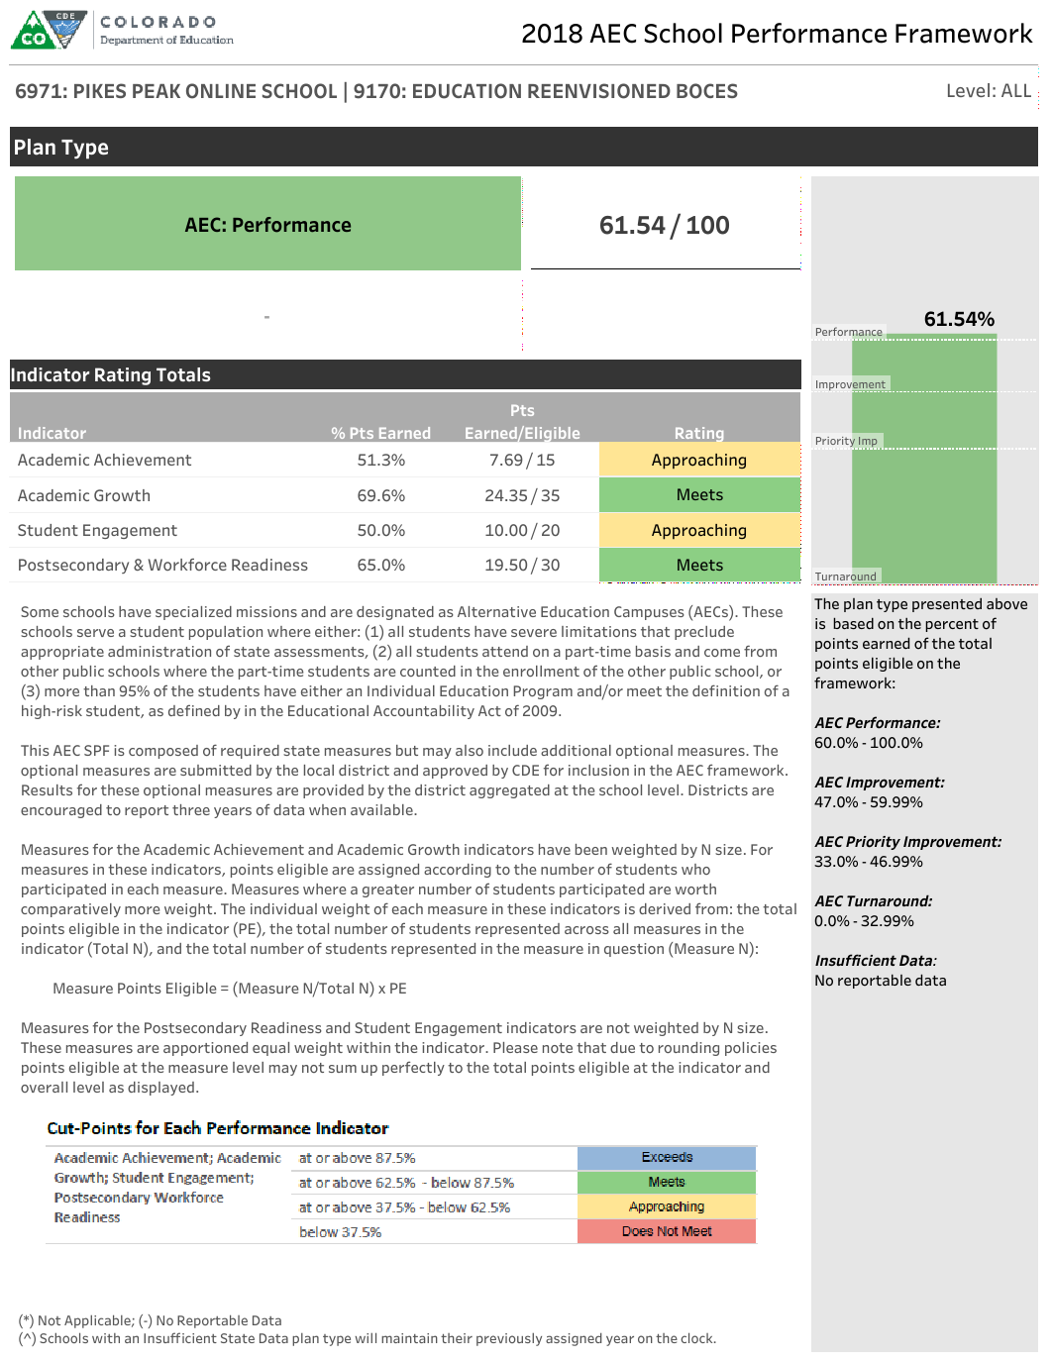
School of reference
This is the official plan type the state assigned to the AEC based on the state required and optional data.
Data set combines EMH levels due to N size weighting for ACH and GRO indicators.
1234: AEC SCHOOL | 1234: RESIDING DISTRICT
Total points earned and total points eligible on the AEC School Performance Framework.
If the AEC is on the Accountability Clock, a notice of the year will be printed here.
This bar chart displays the percentage of points earned overall. The associated scoring rubric for the overall plan type is below.
Four performance indicators to which the AEC are held accountable, along with points earned, points eligible, percent of points earned, and ratings.
Description of weighting structures by indicators is here. N weighting was first implemented on the 2016 AEC SPFs.

Slide 2
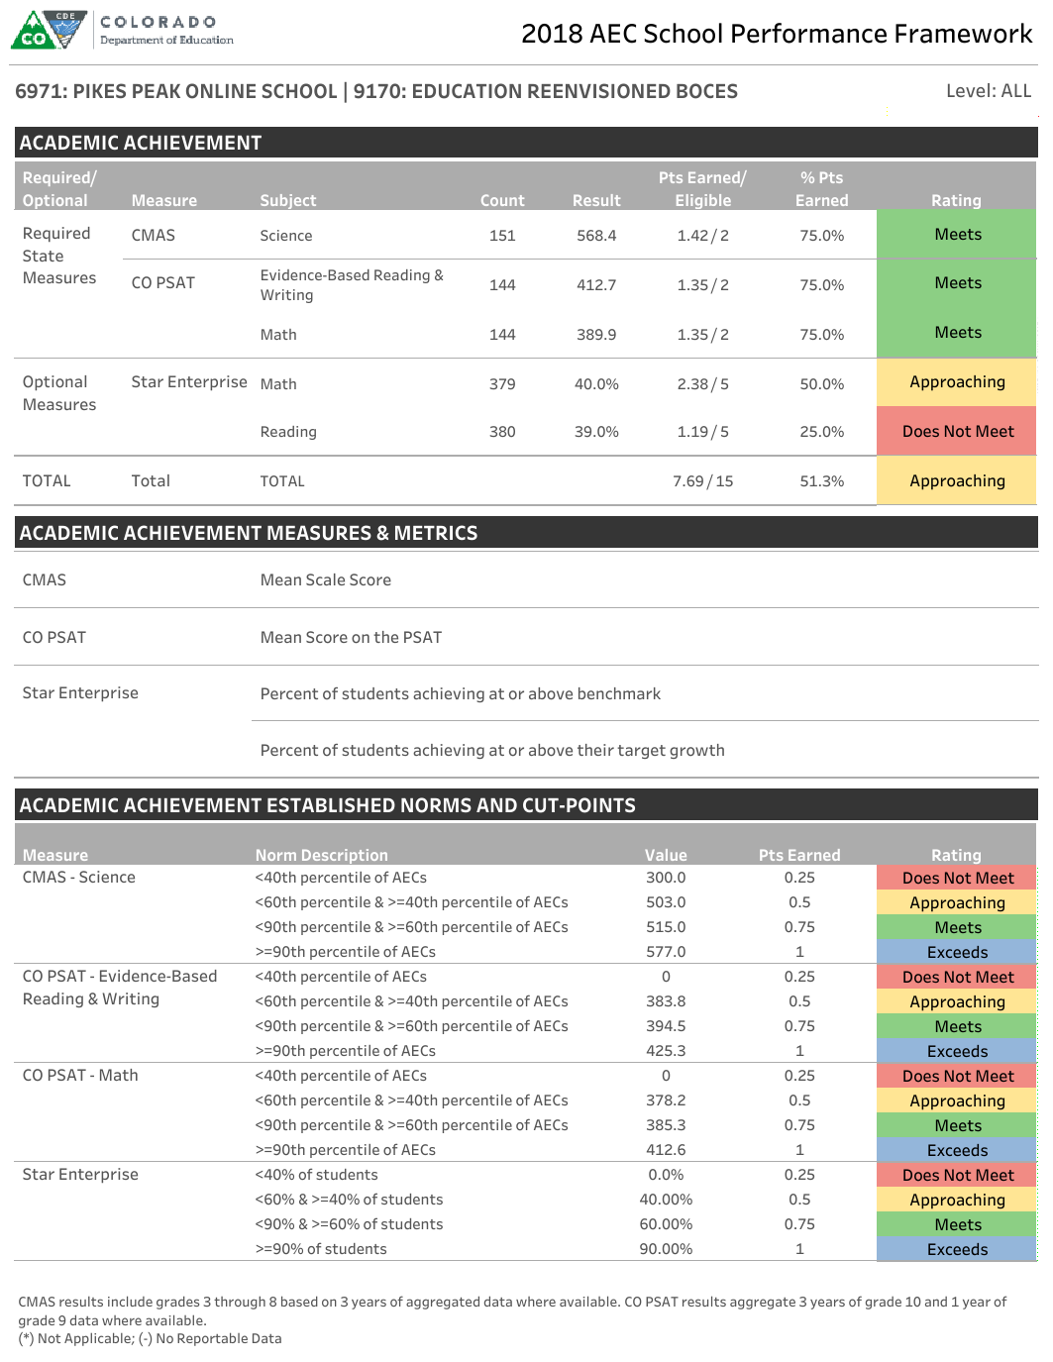
NOTE: State-required Achievement measures include relevant alternate assessment results.
Required state measures will always be displayed, even if the school does not have the N size to be eligible for them.
The count column represents the number of students for which the school is accountable (the measure’s denominator).
1234: AEC SCHOOL | 1234: RESIDING DISTRICT
Total performance on the Academic Achievement indicator, including points earned, points eligible, and rating, is displayed in this row. This indicator uses N size weighting.
Optional measures will only be displayed if they are submitted through the Actual Measures and Data Pipeline Collection and approved for accountability use by CDE.
Each results table is followed by a metric description table, and then by a norm/cut points table.
Together, these two supplemental tables represent a scoring and interpretation guide for each indicator.
To ensure adequate N size, all state reported data in this indicator is aggregated across multiple years of data.

Slide 3
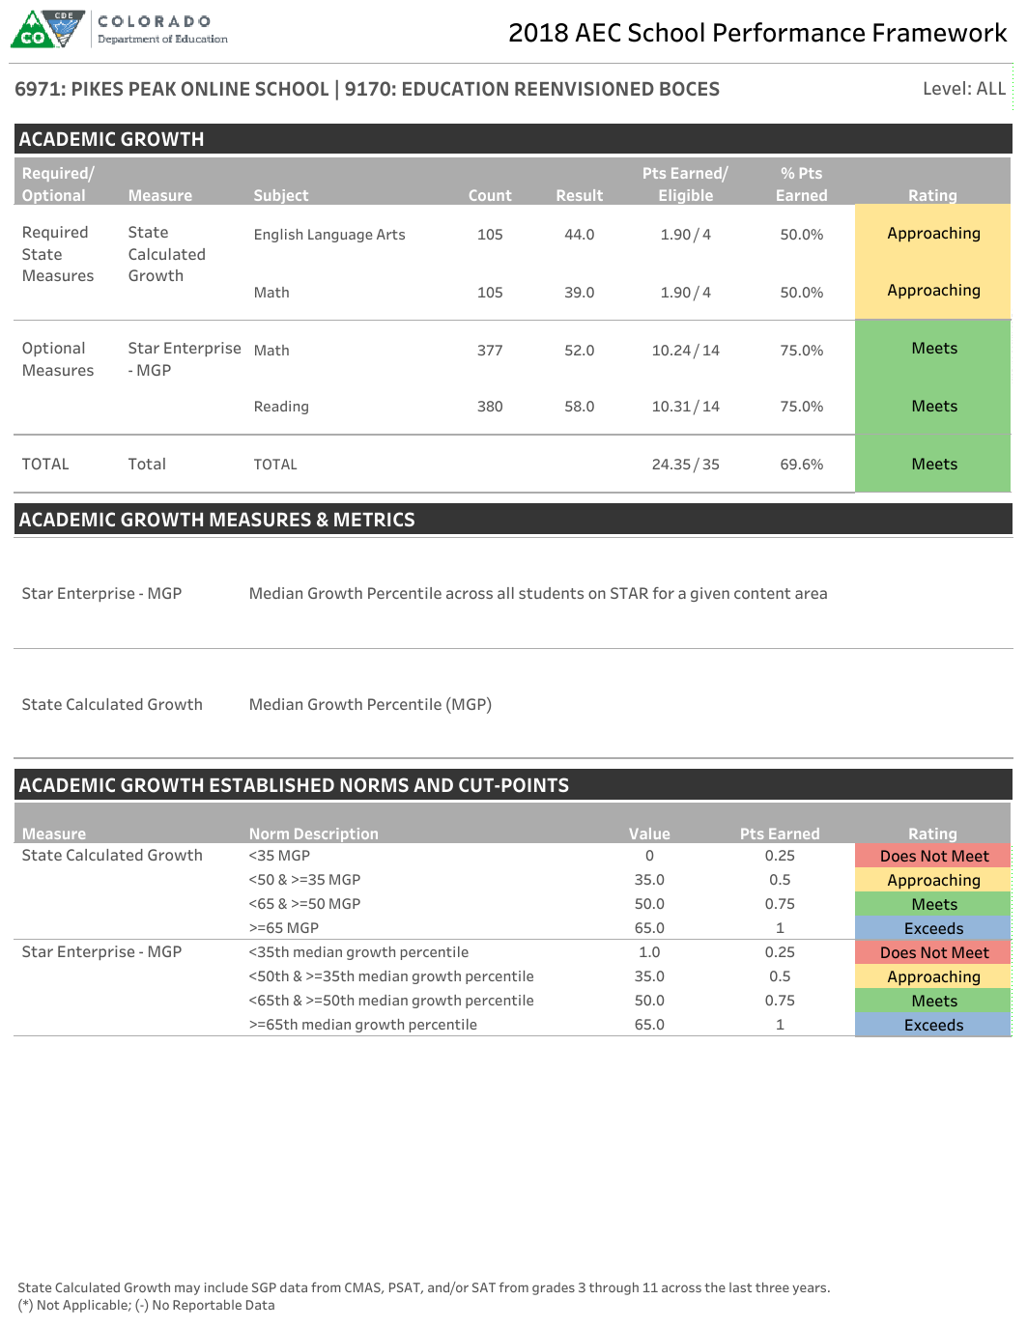
State Calculated Growth is a measure specific to the AEC SPF introduced on the 2018 AEC SPF. This measure takes the Median Growth Percentile for a given content area across all grades and all tests (CMAS, CO PSAT, SAT) for the AEC for the last three years across all available data. To read more about this change, read this fact sheet.
1234: AEC SCHOOL | 1234: RESIDING DISTRICT
Total performance on the Academic Growth indicator, including points earned, points eligible, and rating, is displayed in this row. This indicator uses N size weighting.
Each results table is followed by a metric description table, and then by a norm/cut points table.
Together, these two supplemental tables represent a scoring and interpretation guide for each indicator.

Slide 4
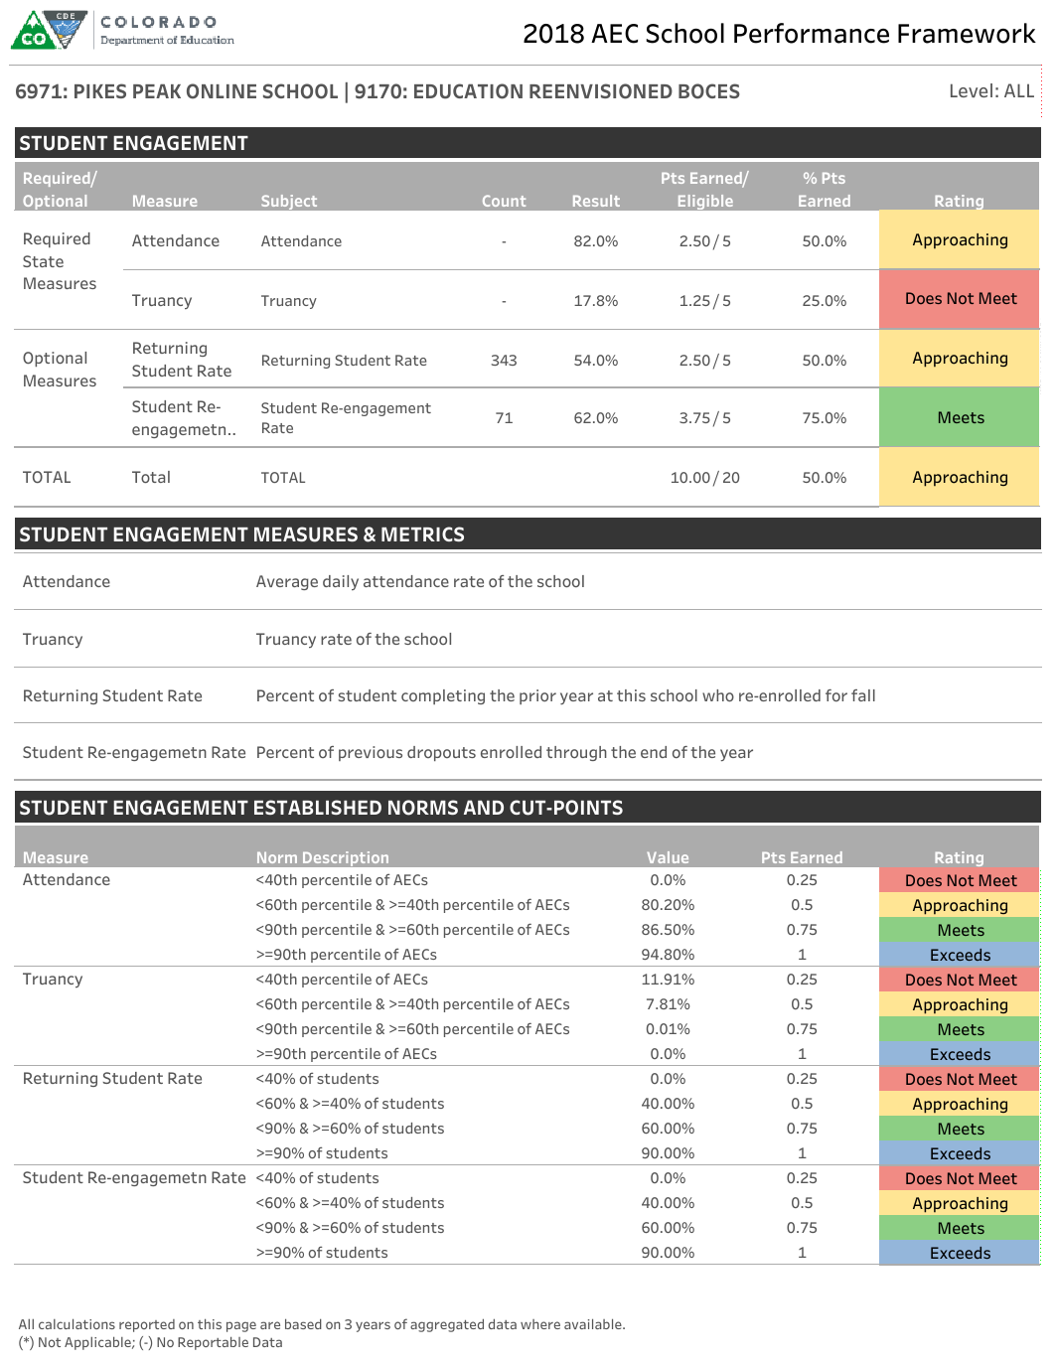
1234: AEC SCHOOL | 1234: RESIDING DISTRICT
Total performance on the Student Engagement indicator, including points earned, points eligible, and rating, is displayed in this row. This indicator apportions equal weight to each measure.
Student Re- engagement
Each results table is followed by a metric description table, and then by a norm/cut points table.
Together, these two supplemental tables represent a scoring and interpretation guide for each indicator.
Student Re-engagement Rate
Student Re-engagement Rate

Slide 5
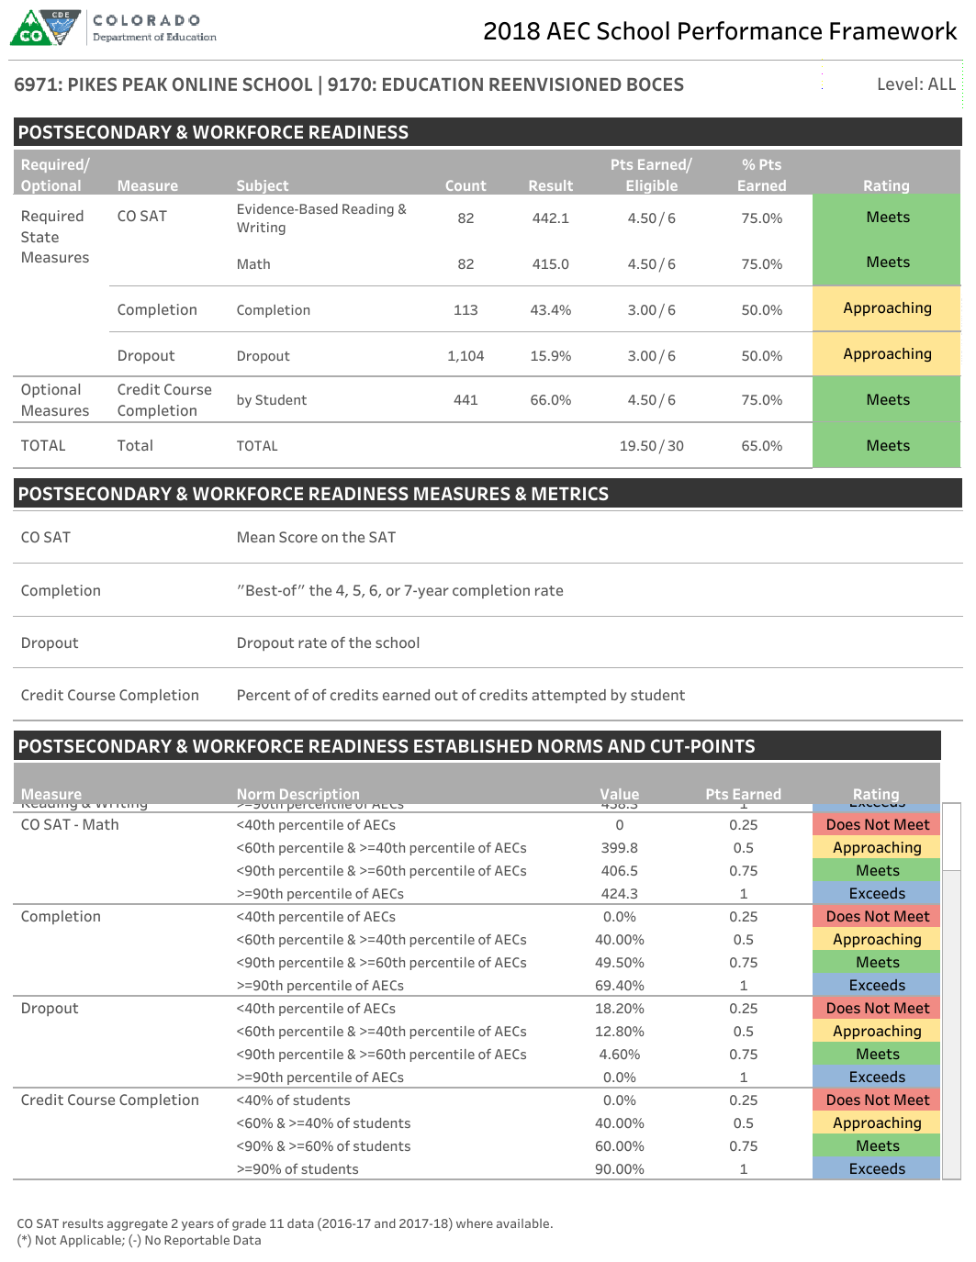
Completion rate includes high school graduates and any other student who completed high school through any additional pathway (ex: GED). Completion rate is the default state required measure for AECs, but AECs can request graduation rates as an optional measure.
NOTE: CO SAT results include relevant alternate assessment results.
1234: AEC SCHOOL | 1234: RESIDING DISTRICT
Total performance on the Student Engagement indicator, including points earned, points eligible, and rating, is displayed in this row. This indicator apportions equal weight to each measure.
Each results table is followed by a metric description table, and then by a norm/cut points table.
Together, these two supplemental tables represent a scoring and interpretation guide for each indicator.
Starting with the 2018 AEC SPF, changes were made to the best of determination calculation for completion and graduation rate. To determine the best of cohort, the most recent three years of each cohort (4, 5, 6, and 7 year) data is first aggregated, and then compared. To read more about this change, refer to this fact sheet.
Questions?
Please direct questions about the AEC SPF calculations to B Sanders, AEC and Accountability Senior Consultant:
Sanders_b@cde.state.co.us
To ensure adequate N size, all state reported data in this indicator is aggregated across multiple years of data.

