Slide 1
Technical Advisory Panel Meeting
November 16, 2023

Slide 2
Welcome & Introductions
Welcome from CDE
The purpose of the TAP is to provide non‐binding technical recommendations to CDE regarding the Colorado Growth Model, state accountability, and other topics as needed.
Meeting Logistics:
Non‐members, please add your Name/Affiliation to the chat box.
Everyone please mute your sound.
We ask all non‐TAP members to hold any comments until the end of the meeting. We do this to ensure we have sufficient time to address all meeting agenda items.
Welcome Pamela Wong, new TAP member and DPS representative! Thank you, Grant Guyer, for serving as interim DPS representative.
Introductions with Ryan Marks, TAP Chair

Slide 3
Agenda for Today
Welcome and Introductions
Information Item
Accountability Updates – Lisa Medler
Information Item
School Code Committee – DJ Loerzel
Feedback Item
On-Track Growth Indicator – Marie Huchton
Feedback Item
Wrap-Up

Slide 4
Accountability Updates Information Item Lisa Medler

Slide 5
Current State Accountability

Slide 6
Overarching Accountability Timeline
2023 Frameworks Released
1241 Task Force Begins*
Fall 2023
2023 Supplemental Framework Report
Winter 2024
Spring 2024
Interim Report Due
2024 Framework with New Measures for Points
Final Report Due
Fall 2024
* Per HB23-1241

Slide 7
2023 State Accountability Timeline
Anticipated Timeframe | Activities/Actions
June 29 | Districts Receive ACCESS Growth Data
August 14 | Districts Receive CMAS and P/SAT Achievement, Growth, Participation Data; UIP Data Dashboards available
August 17 (SBE Meeting) | Public Release of Colorado Growth Data Results; Alternative Education Campus (AEC) Designations Finalized
August 21 | Districts Receive Matriculation Data
August 23 | Preliminary Performance Frameworks Released to Districts. Public release August 29.
September 12 | AEC Performance Frameworks Released
Early September | ESSA Identifications (i.e., CS, TS, A-TS) Released to Districts. Districts will need to notify schools.
September 22 | Accreditation Form Submissions Due for ALL Districts
October 16 | Unified Improvement Plan (UIP) Submissions Due Final Request to Reconsider Materials Due (for participating districts)
November 8-9 (SBE Meeting) | District Accreditation Ratings & School Plan Types Finalized for Districts/Schools not participating in request to reconsider
December 13-14 (SBE Meeting) | District Accreditation Ratings & School Plan Types Finalized for Districts/Schools participating in request to reconsider
By December 31 | District Accreditation Contracts Due
Late January | Informational reports release to districts with new measures (e.g., Science Achievement).

Slide 8
Timeline for Upcoming Accountability Discussions with the State Board of Education
Anticipated Timeframe | Activities/Actions
September 13 & 14 | CDE presents on statewide trends of 2023 Preliminary Performance Frameworks (informational) AND CDE presents on New framework measures (informational)
October 11 & 12 | CDE presents on statewide framework targets for 2024 including anticipated new measures (informational)
November 8 & 9 | SBE votes on 2024 statewide framework targets (vote) AND SBE finalizes District Accreditation Ratings & School Plan Types not participating in request to reconsider (consent item)
December 13-14 | SBE finalizes District Accreditation Ratings & School Plan Types Finalized for Districts/Schools participating in request to reconsider (vote)

Slide 9
State Board Meeting Updates
The state board voted to keep 2024 framework targets (e.g., sub-indicator methodology, overall rating cut points) consistent with 2019 and 2023.
Science will be re-introduced in the Achievement performance indicator.
On Track Growth will be delayed until all schools are ready for release. The department will provide public reports beginning in 2024.
The state will continue to study the PWR Higher Bar measures because of concerns around data quality.
Thank you! The TAP’s recommendations and feedback from the field were factors in the state board’s considerations.
November Board Meeting (Presentation begins at 6 hours 30 minutes)
Accountability Contact Communication for more summary

Slide 10
Task Force Updates

Slide 11
H.B. 23-1241: Accountability, Accreditation, Student Performance, and Resource Inequity Task Force
Link to Bill: https://leg.colorado.gov/bills/hb23-1241
Purpose: Creates a representative task force of 26-members that studies academic opportunities, inequities, promising practices in schools, and improvements to the accountability and accreditation system.
Task Force Website: https://www.cde.state.co.us/accountability/accountability-task-force
Builds upon: Accountability Audit and the Local Accountability System Grant
Timeline:
July 1, 2023: Task force members appointed
August 15, 2023: Department contracted with a facilitator
August 24, 2023: Convened first meeting
March 1, 2024: Interim report
November 15, 2024: Final report reflecting findings and recommendations to the education committees of the house of representatives and senate, the governor, the state board, the commissioner of education and the department.

Slide 12
H.B. 22-1215: Study Of Expanding Extended High School Programs
Link to Bill: https://leg.colorado.gov/bills/hb22-1215
Purpose: Develop and recommend policies, laws and rules to support the equitable and sustainable expansion and alignment of programs that integrate secondary, postsecondary and work-based learning opportunities in every region of the state.
Task Force Website: https://www.cde.state.co.us/postsecondary/secondary_postsecondary_and_work-based_learning_integration_task_force
Timeline:
July 2022: Convened first meeting
December 1, 2022: Interim report
December 1, 2023: Final report reflecting findings and recommendations to the governor, the Education Leadership Council, the State Board of Education, the Colorado Commission on Higher Education, and the Education Committees of the Senate and the House of Representatives, or any successor committees.

Slide 13
School Code Committee Feedback Item DJ Loerzel

Slide 14
Notice of a Rulemaking Hearing for School Code Review Committee

Slide 15
Agenda
Context and Rationale
Walkthrough of Proposed School Code Rules
Discussion

Slide 16
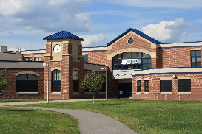
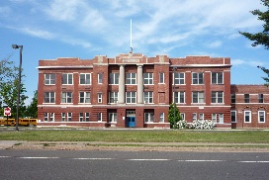
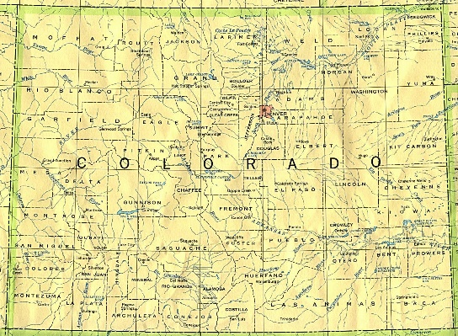
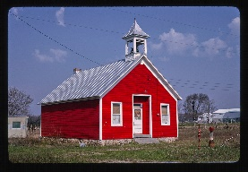
Overview of School Codes – Purpose
School Demographics File
District Code | District Name | School Code | School Name | Grade Span | Charter? | Online?
1234 | Plain Ridge | 5678 | Eagle Elementary | PK-5` | No | No
1234 | Plain Ridge | 6789 | Plain Ridge Online | 6-12 | No | Yes
1111 | River Valley | 7777 | Eagle School | PK-12 | Yes | No
School Grants File
District Code | District Name | School Code | School Name | Grant A? | Grant B? | Grant C?
1234 | Plain Ridge | 5678 | Eagle Elementary | Yes | No | No
1234 | Plain Ridge | 6789 | Plain Ridge Online | No | No | Yes
1111 | River Valley | 7777 | Eagle School | Yes | Yes | No
CDE assigns a school code (unique 4-digit code) to each school and district to connect important information across data systems.
These codes allow CDE to maintain a comprehensive data collection and reporting system to meet State and Federal requirements.

Slide 17
Rationale for State Board Rules for the School Code Process
Build upon current state protocols
Strengthen practices and decisions
Increase transparency
Examples of the Complex Issues to Consider
What happens when grade levels are reconfigured?
What happens when a school closes?
What happens when two schools merge?
What happens to existing grants? Does the new school meet eligibility requirements?
How do we track graduation history?
What happens to accountability history? What if a merging school is on Performance Watch?
What are implications for federal reporting?

Slide 18
Current Practice: School Codes Review Committee (SCRC)
CDE’s School Code Review Committee (SCRC) reviews all school code change requests to maintain accurate information regarding public schools in Colorado.
The SCRC is comprised of individuals from units across CDE to identify potential impacts across the scope of operations and ensure the appropriate assignment of school codes.
The SCRC has provided guidance and a process which is outlined on this website: https://www.cde.state.co.us/datapipeline/schoolcodechanges-firstdraft

Slide 19
Agenda Part 2
Context and Rationale
Walkthrough of Proposed School Code Rules
Discussion

Slide 20
Definition of a Public School
CDE assigns a school code to each public school and each Local Education Agency (e.g., district, CSI, BOCES).
CDE’s operational definition of what qualifies as a public school is based on:
The definition of a school in C.R.S. 22-11-103(28)
Federal standards
Legislative objectives of the Educational Accountability Act and other statutory education programs
This is a brand new set of rules. CDE worked with the AG’s Office to draft the rules.

Slide 21
Description of the Proposed Rules
Section | Brief Description
Section 1.00 Statement of Basis and Purpose | Describes the rationale for the school code process.
Section 2.00 Process for Assigning School and LEA Codes | Describes the SCRC and their responsibilities. Also lays out a reconsideration process for LEAs.
Section 3.00 Standards for Assigning School and LEA Codes | Describes the parameters the SCRC must consider when making decisions.

Slide 22
Deeper Dive on Section 3.00: Standard for Assigning School Codes
A school code will generally follow the weight of the students enrolled within the school
To give weight to student enrollment, CDE will presume:
If a school or schools merge into another school that provides essentially the same grades, the smaller entity’s or entities’ school code(s) would be retired while the larger entity’s school code should survive.
When two or more schools of equal size or with different grade spans are merged within an existing or new physical location, the school code for the existing entities can be retired and a new school code granted.
Even if an LEA does not call something a consolidation or merger, CDE may consider a closure to be a merger or consolidation for purposes of school code assignment.

Slide 23
Deeper Dive on Section 3.00: Standard for Assigning School Codes (cont’d)
The presumption that a school code follows the weight of students may be rebutted based on:
Enrollment boundaries and impact of choice on enrollment patterns;
Whether the request pertains to online or brick-and-mortar schools;
Accountability history of the schools in question and whether supports to improve student outcomes will be impacted (e.g., grant funding);
Organizational, curricular, or programming model differences between the closing school(s) and the new or surviving school;
Leadership and staffing differences between the closing school(s) and the new or surviving school;
Facilities (e.g., new construction vs. existing facilities);
Grades served;
Whether the requested action is part of a State Board order; and
Any other information relevant to the request.

Slide 24
Application of Standard
CDE will develop specific guidelines for the implementation of the standard outlined in rule.
The Committee’s determinations may include:
Granting the request without modification;
Treating a proposed closure of a code as a merger of existing codes;
Treating a proposed new code as a continuation of an existing code; or
Assigning new codes when the grade span of an existing code changes substantially.

Slide 25
Reconsideration Process
If a requester disagrees with the Committee's decision, the requestor may ask CDE to reconsider.
The request will be reviewed by CDE leadership in the Data Operations Unit and the School Quality and Support Division.
If the recommendation from CDE leadership is to uphold the Committee decision, final approval from the Commissioner will be sought. CDE will issue a written response regarding its decision on the request. At this point, the decision will be final.

Slide 26
Rulemaking Process and Timeline
Dates | Activities
October 2023 | Notice of rulemaking hearing
October and November 2023 | Opportunity for members of the public to submit written comments on proposed rules
December 2023 | Rulemaking hearing and board may vote to approve rules
January 2024 | If board is not unanimous in approving rules in December, board may vote to approve rules in January
February 2024 | SCRC uses adopted rules to guide practice when considering applications from LEAs

Slide 27
Questions?

Slide 28
Break
(10 minutes)

Slide 29
On Track Growth
Feedback Item Marie Huchton

Slide 30
On Track Growth | Overview
Colorado’s educational accountability law requires a metric that determines whether a student is making enough growth to reach a target level of achievement within a given timeframe. This measure has not been included in frameworks since 2015, when it was referred to as adequate growth.
In 2019, the State Board of Education voted to adopt the following methodology for On Track Growth for grades 3-8:
Catch Up: Whether students scoring below grade level are catching up to grade-level expectations within two years.
Keep Up: Whether students who are already meeting grade-level expectations are maintaining their performance for three years.
A methodology still needs to be determined for high schools and districts.

Slide 31
SBE Decisions
State Board agreed with TAP recommendation to postpone inclusion of On Track Growth in frameworks until all grade levels are available.
Until then, Elementary and Middle school On Track Growth should be reported for informational purposes.

Slide 32
Reporting
On Track Growth

Slide 33
Today’s Conversation
What would be a helpful way to release CMAS ELA and Math On Track Growth data to districts?
Data files
Student-level reports
School/district-level reports
Explanatory Resources

Slide 34
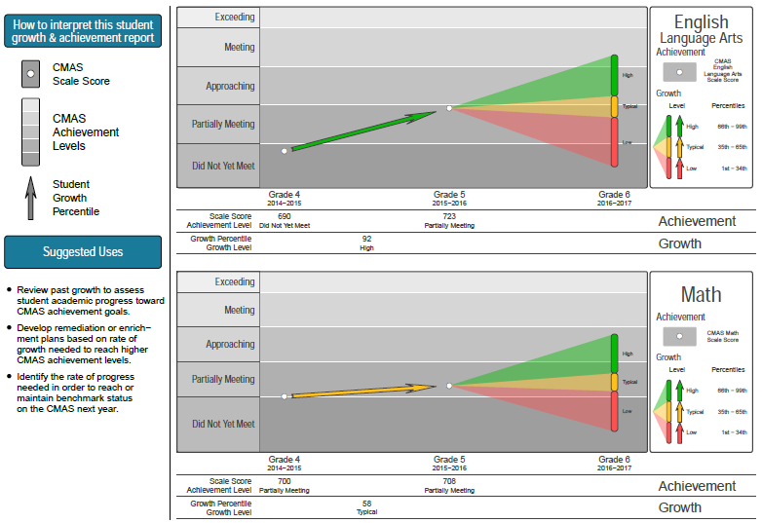
Individual Student Growth Report (ISR)

Slide 35
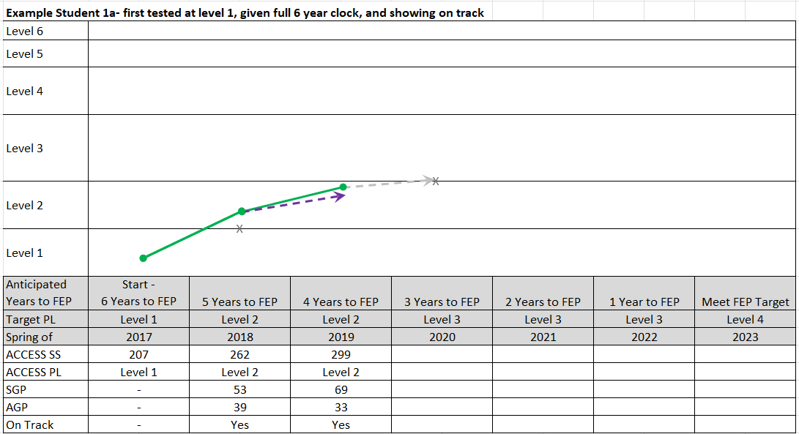
Proposed Student Level WIDA ACCESS On Track Graphic

Slide 36
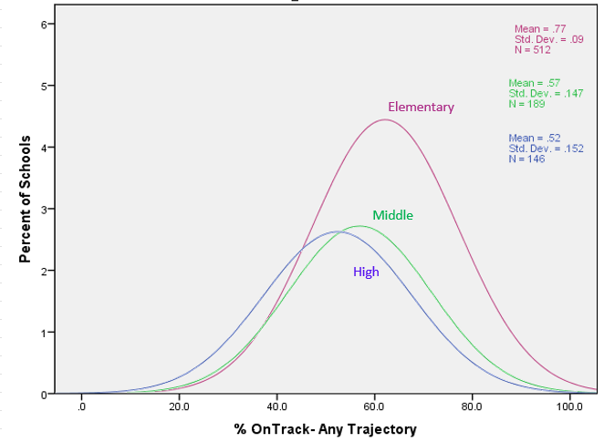
School Level On-Track Distribution Example

Slide 37
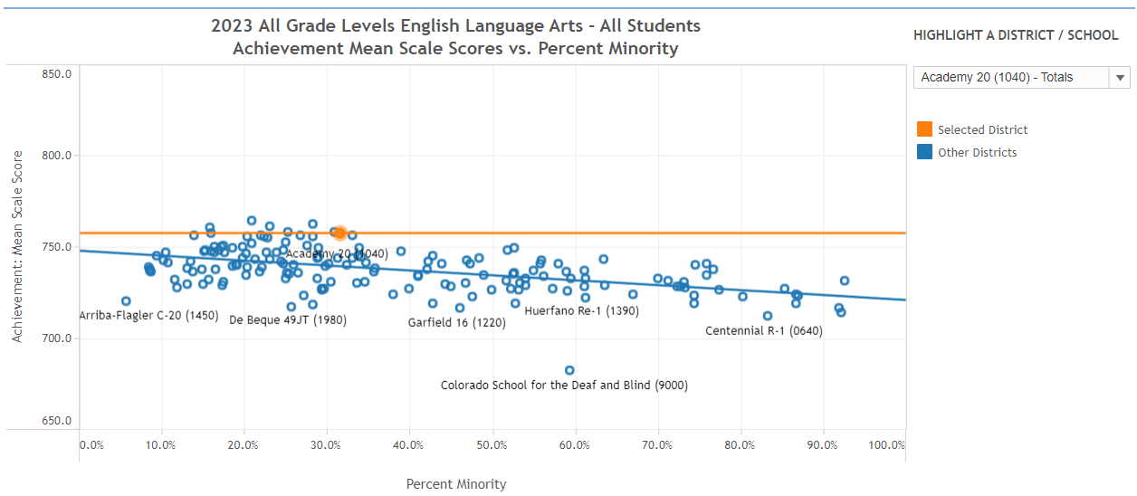
Data Explorer Tool- Performance by Demographics

Slide 38
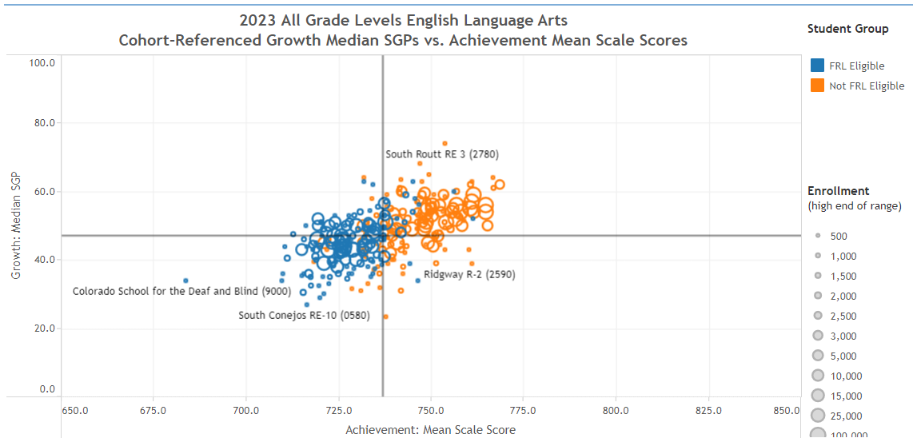
Data Explorer Tool- Achievement v. Growth

Slide 39
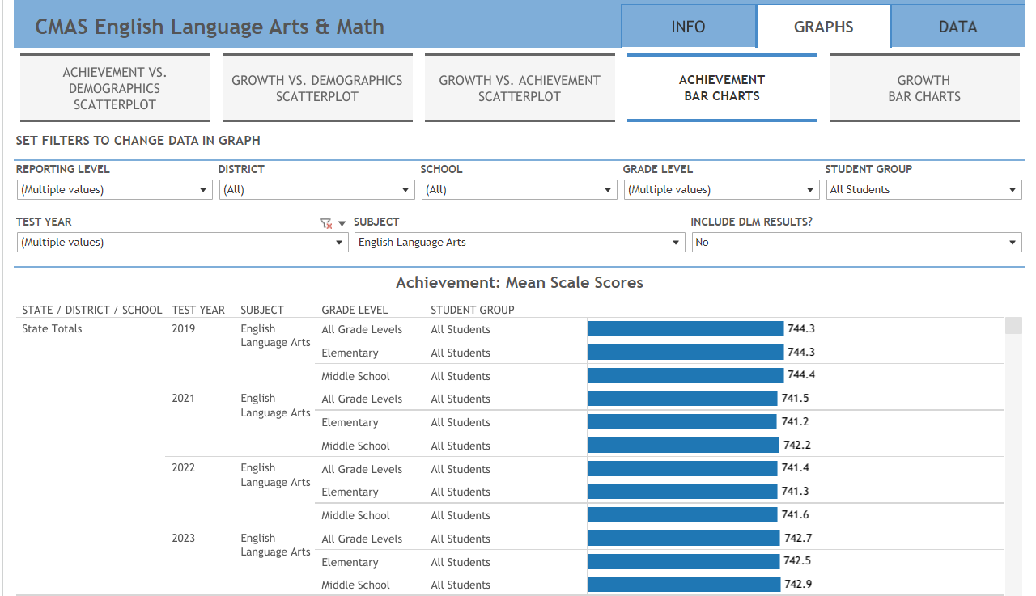
Data Explorer Tool- Performance Bar Charts

Slide 40
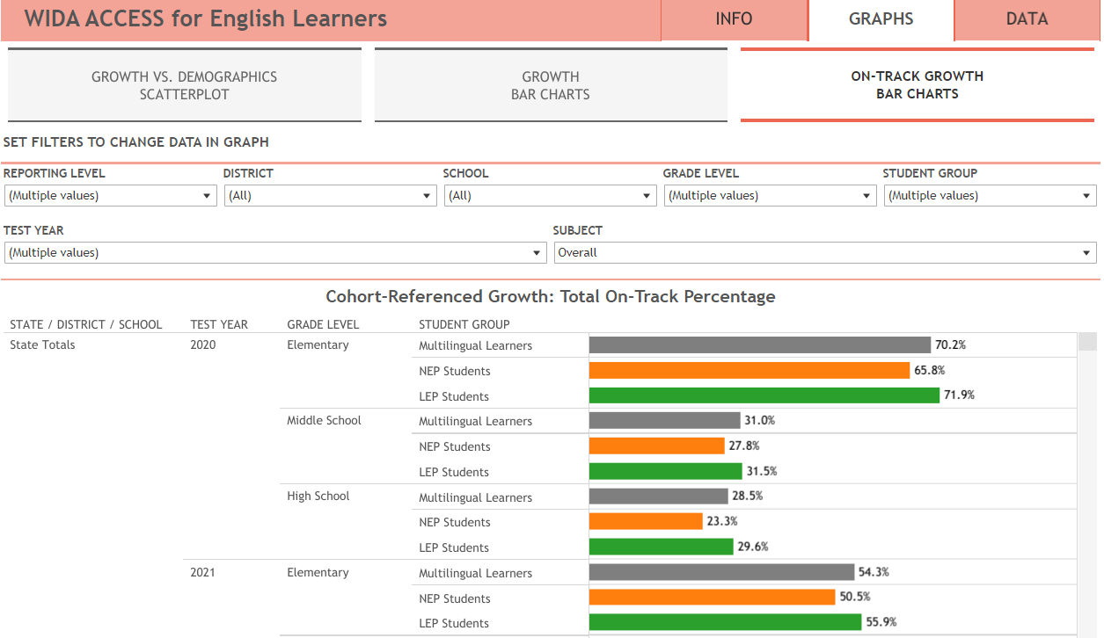
Data Explorer Tool- On Track Growth Bar Charts

Slide 41
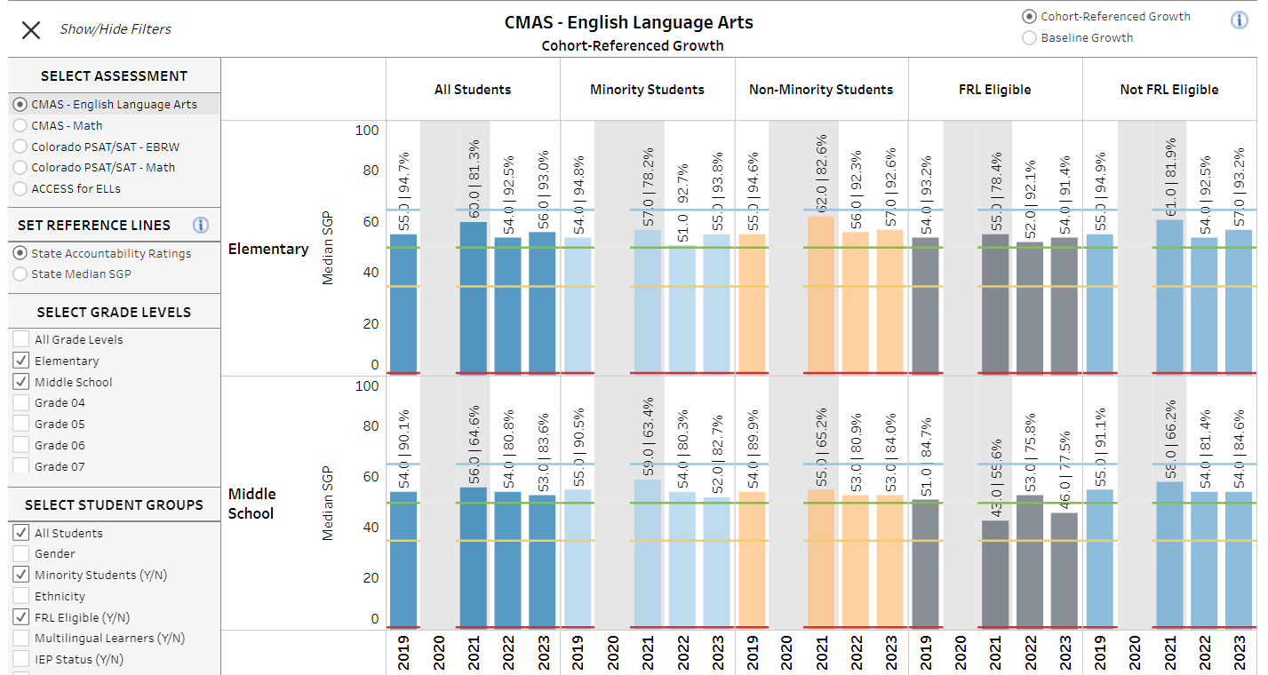
Dashboard- Growth Bar Charts

Slide 42
Public Comments and Meeting Close

Slide 43
Technical Advisory Panel
Meeting Summary
Suggested future analysis
TAP recommendations from this meeting
Public Comment
Close Meeting - Happy Holidays!
Next Scheduled Meeting: January 18th, 1-4pm
We’re currently recruiting a rural representative for the TAP. The application link is available here: https://www.cde.state.co.us/accountability/tap.

