Slide 1
Why Don’t They Understand How Wrong They Are?
Steven P. Dykstra, PhD
Psychologist, Social Scientist, Statistician, Founding Member Wisconsin Reading Coalition, Speaker, Photographer, Butterfly Rancher…

Slide 2
I decided to start by telling you about me.

Slide 3
I know you’re right, but it seems like you’re calling me stupid, and I don’t like it.

Slide 4
This was the Worst Marketing Plan, Ever!
Marketing Matters, and…

Slide 5
“I am so experienced, I can just tell.”

Slide 6
No One Can Just Tell!
The orbits of the solar system
Phrenology
House-Tree-Person
Racism, Sexism, and every other ‘ism
Albert Einstein
Ignaz Semmelweis

Slide 7
Where Shall We Begin?
Boston
Horace Mann
Thomas Gallaudet
1837

Slide 8
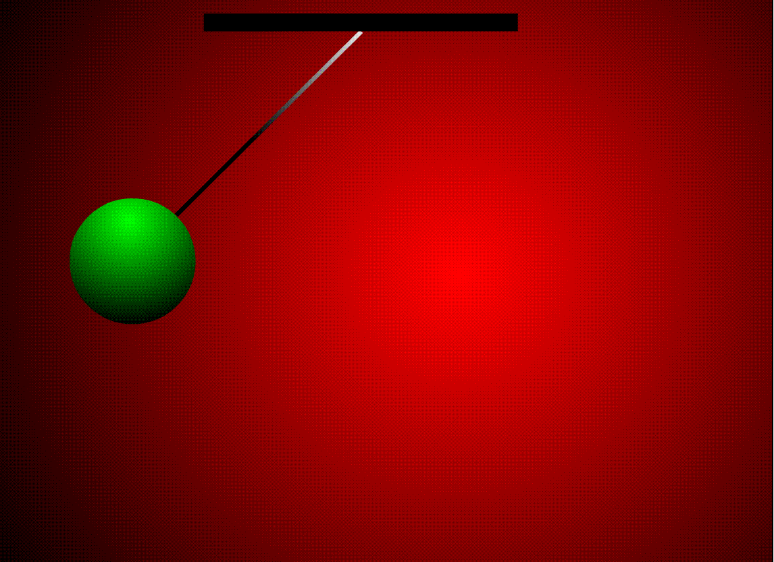
The Pendulum Years

Slide 9
The Pendulum Years
Little or no systematic science
Data is crude
Analysis almost nonexistent
Decisions made on the basis of preference, fashion, and personal experience
Extremely vulnerable to bias and all the isms

Slide 10
Attempts at Reason and Science
Samuel Torrey Orton (1879-1948)
Anna Gillingham (1878-1963)
Rudolf Flesch (1911-1986)
Why Johnny Can’t Read (1955)
Computers and the “discovery” of phoneme awareness and blending

Slide 11
1967 The Beginning of a Post Pendulum World
Politics, Unrest, Social Upheaval, and the end of the Pendulum Years
What you see today, is not a pendulum swinging
What you see today is rooted in 1967

Slide 12
Learning to Read: The Great Debate
Jeanne Chall, 1967
372 pages

Slide 13
Chall, The Great Debate
Sifts and winnows decades of shoddy science and spotty data
Concludes teaches do better with what they know best
Teachers who know how to teach “phonics” do better than those who teach see-say, whole word, or other meaning-based approaches
The misrepresentations

Slide 14
The First Grade Studies
Bond and Dykstra, 1967
Over 1,000 pages (The executive summary is well over 100 pages!)

Slide 15
Bond and Dykstra
27 different projects at 27 different sites, done 27 different ways
Were social, classroom, and community factors important?
Was there an approach that worked best?
Phonics/Linguistic, plus reading for meaning, plus writing
See-say, meaning based, whole word approach was the least effective by far
The misrepresentations

Slide 16
Reading: A Psycholinguistic Guessing Game
Ken and Yetta Goodman, 1967
9 pages

Slide 17
The Guessing Game
Republished in at least 5 books over the next decade
Concludes readers do best when using contextual and other cues to identify words
Gives Explosive Rise to the “3-cues”
Major Design Flaws
Replications reveal this is only how the poor readers read

Slide 18
Where you land on issues of how to teach reading is, to a large extent, determined by how you or others reacted to these 3 studies from 1967. Even if you never read them, you learned from or were influenced by others, who were influenced by others, who are all connected in a direct line back to these three studies. You need to know that!

Slide 19
Two Camps
Science
A Movement
Chall, Adams, Moats, Torgesen, Lyon, Molfese, Seidenberg, Shaywitz, Ehri, Wolfe, many others
Until recently, writing mostly for a scientific audience
The pace of science is slow
Goodman, Smith, Allington, Krashen, Clay, Fountas. Pinnell, Calkins, many others
Create new rules and definitions of science to suit them
Compared to science, movements are agile and fast-moving

Slide 20
What is the War About?
We agree about reading for meaning.
We agree on the importance of writing
We agree comprehension is the goal of everything.
We all want children to love reading.
We all want children to be successful.
We’re all sincere.
We’re all dedicated.
We all work hard.
There is one great difference?

Slide 21
What is the thing to do when you come to a word you don’t recognize?
That’s it. That’s the disagreement. Every difference flows from how we answer that question.
If you are descended from Goodman, Smith, and Clay, et al you have one answer?
If you are descended Chall, Moats, Adams, et al you have a different answer.

Slide 22
"Reading without guessing is not reading at all"
Smith, F. (1973). Psychology and reading. New York: Holt, Rinehart & Winston.

Slide 23
"Effective readers use all three cueing systems interdependently. Ineffective readers tend to rely too heavily upon graphophonic cues" (p. 41).
Routman, R. (1988).Transitions: From literature to literacy. Portsmouth, NH: Heinemann.

Slide 24
“Skill in reading involves not greater precision, but more accurate first guesses based on better sampling techniques, greater control over language structure, broadened experiences and increased conceptual development”
Goodman, K. (1976). Reading: A psycholinguistic guessing game. In H. Singer & R. Ruddell (Eds), Theoretical models and processes of reading (pp. 497-508). Newark, DE: International Reading Association.

Slide 25
“Accuracy, correctly naming or identifying each word or word part in a graphic sequence, is not necessary for effective reading since the reader can get the meaning without accurate word identification…. Furthermore, readers who strive for accuracy are likely to be inefficient”. p.826.
Goodman, K. S. (1974, Sept). Effective teachers of reading know language and children. Elementary English, 51, 823-828.

Slide 26
“All readers, from five year old beginners on their first books to the effective adult reader need to use: the meaning, the sentence structure, order cues, size cues, special features, special knowledge, first and last letter knowledge before they resort to left to right sounding out of chunks or letter clusters, or in the last resort, single letters.” (p. 9)
Clay, M. (1998). An observation survey of early literacy achievement. Auckland, Heinemann.

Slide 27
“Whole language is still with us, strongly embedded in current curriculum, pedagogy and assessment strategies. Adversaries of whole language still complain that the term whole language may not be used, however the philosophy is alive and well in each state system … An outcome of this inclusiveness was a move away from using the term whole language and simply using literacy. To us the principles underpinning the word literacy were similar but did not bring with it the negative connotations” (p.23).
Cambourne, B. & Turbill, J. (2007). Looking back to look forward: Understanding the present by revisiting the past: An Australian perspective. International Journal of Progressive Education, 3(2), 8-29.

Slide 28
https://www.nifdi.org/news/hempenstall-blog/442-part-2-what-whole-language-writers-have-had-to-say-about-literacy

Slide 29
BUT!
For most of us, we are mostly in one camp or another because of others. Other colleagues, professors, friends; who we took a class from in college, where we went to school, the program someone handed you on your first day.
This was, to a great extent, not our decision. Certainly, not our decision alone.
What we know and believe is always the result of agency, community, and plain old random chance.
We believe because of the facts we know, and we filter what we know because of what we believe.

Slide 30
I will tell you…
About Adams, Beginning to Read, 1990
The National Academy of Sciences, Snow, 1998
The National Reading Panel
About the complete lack of evidence to support the 3 cues for decoding
Come to my other presentation…

Slide 31
But each of you will filter and understand all of it differently because of the camp you are in. Some of you are cheering me on. Some of you, not so much.

Slide 32
Let me share the results of an ongoing, unpublished, large scale study you’ve never seen. Let me tell you about Massachusetts, Florida, and Wisconsin

Slide 33
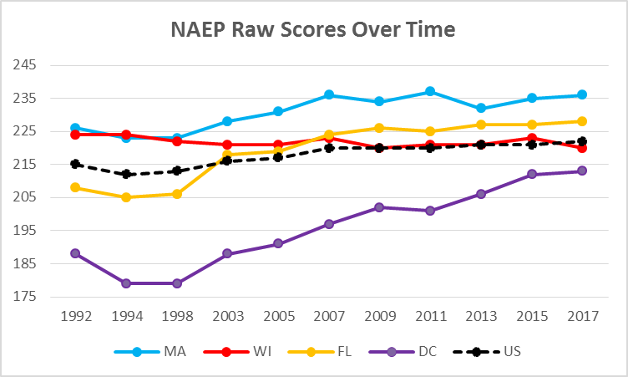

Slide 34
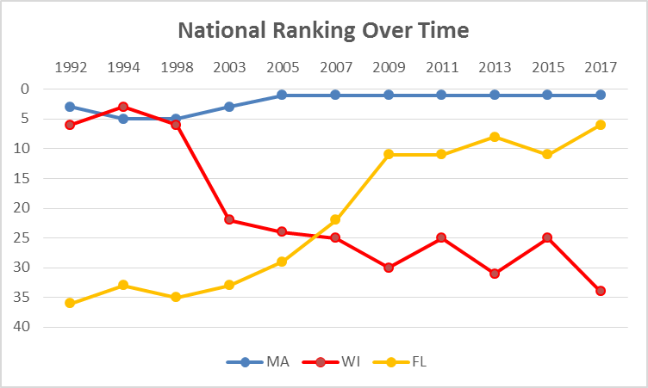

Slide 35
Let me tell you about Mississippi and Wisconsin
Wisconsin ranked 34th in 2017
Mississippi ranked 45th
Buuuuuut…..
It’s not that simple

Slide 36
Poor Black Kids
Wisconsin ranked 38th out of 39
Mississippi ranked 16th
Statistically significant
8/16 32 1998
201.43 vs 188.73

Slide 37
Not Poor Black Kids
Wisconsin ranked 10th out of 23
Mississippi ranked 4th
Difference of more than 9 points
Samples were too small to allow significance

Slide 38
Poor White Kids
Wisconsin ranked 47th out of 50
Mississippi ranked 9th
Significantly better
6/28 39 1998

Slide 39
Not Poor White Kids
Wisconsin ranked 48th out of 51
Mississippi ranked 7th
Significantly better
8/37 40 1998

Slide 40
If you want, you can ignore me.
Or…

Slide 41
We need you. We need all of you. We need all of you to come along.
And remember, try to forget the bad marketing. Don’t let it be personal

Slide 42
Photo Album
by steve dykstra

